Slide 1



Reducing the GPU
Memory Bottleneck with Lossless Compression for ML
Aditya K Kamath^, Arvind Krishnamurthy^, Marco Canini*, Simon Peter^
^University of Washington
*KAUST
Notes:
Hi everyone, my name is Aditya K Kamath, and today I’ll be talking about Reducing the GPU memory bottleneck with lossless compression for ML.

Slide 2
The GPU memory bottleneck in ML
CPU
GPU
…
Memory
Core
Core
PCIe
Memory
Data
Data exceeds GPU
memory capacity
Notes:
[click] Data used by machine learning frequently exceeds the capacity of GPU memory, causing issues during training and inference

Slide 3
The GPU memory bottleneck in ML
CPU
GPU
…
Memory
Core
Core
Data
PCIe
Memory
Data $
Model
Kept in CPU memory,
transferred as needed
Notes:
To resolve this, machine learning frameworks place the data in the larger CPU memory instead, and a software cache of frequently accessed data is maintained within GPU memory.
[click] Cache misses are then transferred on-demand to the GPU across the PCIe interconnect.

Slide 4
The GPU memory bottleneck in ML
CPU
GPU
Processing
…
Memory
Core
Core
Data
PCIe
Memory
Data $
Model
Next
transfer
Waiting!
Notes:
This data is then processed on the GPU as before. Since data must be transferred before processing, the PCIe ends up forming the bottleneck, [click] causing the GPU to frequently wait until data reaches it before it can begin execution.

Slide 5
The GPU memory bottleneck in ML
Models examined across training and inference
CPU
GPU
…
Memory
Core
Core
Data
PCIe
Memory
Large Language Models
(LLM)
Graph Neural Networks (GNN)
Recommendation
Models
(DLRM)
Data $
Model
Waiting!
Notes:
This problem is not unique to a specific ML model. We’ve found that this occurs across ML applications, including graph neural networks, recommendation models, and large language models. It’s prevalent across both training and inference. [click] We ran an experiment using a GNN training framework called Legion on an A100 GPU. This framework overlapped PCIe transfers with training computation. We found up to 70% of the end-to-end training time was spent waiting for the transfers to complete, despite both happening in parallel.

Slide 6
Quantization helps transfers but hurts accuracy
Quantization (lossy compression) is a popular research approach
  Compresses data by 2 – 16x
In practice, difficult to deploy
  Accuracy tradeoff must be tuned specifically to each model
  Still leads to unpredictable changes in model behavior [1]
  Risk of revenue loss (even with 0.1% accuracy drop) [2]
[1] Accuracy is Not All You Need [NeurIPS ‘24]
[2] Understanding training efficiency of deep learning recommendation models at scale [HPCA ‘21]
Notes:
Quantization is a possible technique to relieve this overhead. [click] Quantization can provide an order of magnitude of compression. [click] Unfortunately, quantization has tradeoffs making it difficult to deploy. Model accuracy dips requiring it to be finetuned for each model. Even then, prior work has shown that model behavior can change in unpredictable ways, like LLMs rambling more. The risk of revenue loss can lead to users being hesitant to deploy this.

Slide 7
Lossless compression to the rescue?
Tested lossless compression via 8 SOTA algorithms:
Can provide good space savings
  zStd reduced LLM KV-cache size by ~40%
But often too slow for drop-in use in ML applications
  Especially poor on dense floating-point data (up to 10x slowdown)
Problems:
Large metadata overhead
Multiple memory (often PCIe) accesses for decompressing each data word
Notes:
Instead, we look at whether lossless compression could help.
[click] We examined 8 state of the art GPU decompression schemes to transfer ML data across the PCIe. [click] We found that while they may compress data well, [click] their decompression throughput is poor leading to slowdowns. [click] There were a few different causes. One is that some compression algos use large amounts of memory to store metadata like dictionaries, that scale with the input size. They also require multiple PCIe accesses to decompress each data word. We see that existing algorithms are not satisfactory.

Slide 8
Our goal: Practical compression for ML
Applicable to a wide variety of ML applications
  Must be lossless to avoid accuracy tradeoffs
Fully exploit the GPU to avoid slowdown
  Easily parallelizable decompression
  Minimal metadata
  Minimize PCIe accesses
Notes:
Our goal is to provide practical compression for machine learning. [click] It must be applicable to a wide variety of applications, so we stick to lossless compression to avoid accuracy tradeoffs. [click] We also need them to full exploit the GPU, meaning easily parallelizable, minimal metadata, and reduced PCIe accesses.

Slide 9
Bit packing: A good start
Traditionally used to compress integers
  Removes low entropy prefixes
Cheap bitshift operations
Minimal metadata
  No dictionaries
Sequential reading of compressed data
Compressed data
0 0 0
0 0 0
0 0 0
0 0 0
0 0 0
1 0 0 1 0 1 1 0 1
0 0 0 1 1 1 1 0 0
0 0 0 1 1 0 1 0 0
1 1 0 1 0 0 1 0 1
0 0 1 1 0 1 1 0 0
Data
elements
Low entropy
prefixes
Notes:
We found bit packing provides a good start. It's typically used to compress integers by removing low entropy prefixes. [click] It uses cheap bitshift operations, allowing for high throughput. [click] It does not make use of any dictionaries, meaning metadata use is minimal and [click] data accesses for decompression are sequential.

Slide 10
Bit packing is not enough for ML
Evaluated bit packing across 8 ML datasets
Finding: classical bit packing struggles for ML data
  Floating point data may not always have matching prefixes
But: bit values repeat across most tensors (invariant bits)
 | GNN | DLRM | LLM
Bit pack % | 0 - 76% | 0% | 0%
Invariant % | 13 – 99% | 15% | 5 – 12%
Notes:
We evaluated bit packing for GNNs, DLRMs, and LLMs, and found that it struggles with compression, since floating points in a tensor don't always have matching prefixes. [click] However, we find that bit values often repeat across most tensors. We use the term invariant bits to represent the bit positions that have the same bit value across a majority of the tensors, using a threshold percentage to decide how many bits need to match.

Slide 11
What are invariant bits?
Invariant bits
Non-invariant bits
0 0 0
0 0 0
0 0 0
0 0 0
0 0 0
1 0 0 0 0 1 1 0 1
0 0 0 0 1 1 1 0 0
0 0 0 1 1 0 1 0 0
1 1 0 0 0 0 1 0 1
0 0 1 0 0 1 1 0 0
Tensors
Invariant bit positions
80% of tensors’ bits have matching value
Notes:
We introduce a notion of invariant bits. [click] Here, we use a threshold of 80%, so bit positions where 80% of the bits across tensors exhibit the same value are called Invariant bit positions. The bits which match the matching value, marked in red are called invariant bits.

Slide 12
Invariant Bit Packing (IBP)
Identify invariant bits that exist across tensors
Eliminate them, packing the remaining bits into a smaller space
Keep small set of metadata in GPU memory (order of KBs)
Warp-parallel iterative decompression for improved parallelism
Notes:
Based on this observation, we present invariant bit packing, a novel way to pack ML tensors for compression and decompression. Our algorithm identifies invariant bits across tensors. It then eliminates them packing the remaining bits into a smaller space. It retains one set of metadata for decompression in GPU memory, typically in the order of KBs. For parallelism, we introduce warp-parallel iterative decompression.
We now look at how we preprocess and compress this data to remove invariant bits.

Slide 13
IBP: Preprocessing
Invariant bits
Non-invariant bits
0 0 0
0 0 0
0 0 0
0 0 0
0 0 0
1 0 0 0 0 1 1 0 1
0 0 0 0 1 1 1 0 0
0 0 0 1 1 0 1 0 0
1 1 0 0 0 0 1 0 1
0 0 1 0 0 1 1 0 0
Tensors
Mask: 1 if bit position is invariant
Mask
1 1 1 0 1 1 1 0 0 1 1 0
Bitval: Value of the invariant bits
Bitval
0 0 0 * 0 0 0 * * 1 0 *
IBP metadata (In GPU)
Notes:
We introduce new metadata shared across all the tensors. The mask contains a 1 when a bit position has an invariant bit, and a 0 when a position does not.
[click] The bitval stores the value of invariant bits. This is calculated by counting the bits set in tensors column-wise. We do this for the entire dataset to accurately find the invariant bits. In our paper we show that we can also sample a subset of the tensors and retain good performance.

Slide 14
IBP: Compression
Invariant bits
Non-invariant bits
0 0 0
0 0 0
0 0 0
0 0 0
0 0 0
1 0 0 0 0 1 1 0 1
0 0 0 0 1 1 1 0 0
0 0 0 1 1 0 1 0 0
1 1 0 0 0 0 1 0 1
0 0 1 0 0 1 1 0 0
Break tensor into chunks for parallelism and compressibility
Participation
bits
0 0 0 0 0 0 1 1 0 1 0 0
1 0
Mask
1 1 1 0 1 1 1 0 0 1 1 0
Participation bit = 1 if chunk matches Bitval
Bitval
0 0 0 * 0 0 0 * * 1 0 *
IBP metadata (In GPU)
Notes:
Now that we have constructed the bitval and mask, we look at how we use it to compress a singular tensor. [click] First, we break the tensor into chunks to improve parallelism and compressibility. In the figure this is 6 bits per chunk, in reality, this is typically 4 or 8 bytes.
[click] For each chunk we generate a participation bit. This bit is 1 if the chunk completely matches the bitval, or 0 otherwise.

Slide 15
IBP: Compression
Invariant bits
Non-invariant bits
Participation bit = 1, copy non-invariant bits
Compressed data (In CPU)
1 1 0 1 0 0
1 0
0 0 0 0 0 0 1 1 0 1 0 0
0
Mask
1 1 1 0 1 1 1 0 0 1 1 0
Participation bit = 0, copy entire chunk
Bitval
0 0 0 * 0 0 0 * * 1 0 *
IBP metadata (In GPU)
Notes:
Now, we add the remaining bits. [click] If the participation bit is 1, we only add the bits not part of the bitval, which is 0 in the figure. [click] If the participation bit is 0, we add the entire chunk. [click] This becomes our compressed tensor, kept in the CPU, while the bitval and mask are kept in the GPU.

Slide 16
IBP: Tensors after compression
Invariant bits
Compressed data (In CPU)
Non-invariant bits
0 0 0
0 0 0
0 0 0
0 0 0
0 0 0
1 0 0 0 0 1 1 0 1
0 0 0 0 1 1 1 0 0
0 0 0 1 1 0 1 0 0
1 1 0 0 0 0 1 0 1
0 0 1 0 0 1 1 0 0
1 1
1 1
1 0
0 1
0 1
1 0 1 1
0 1 1 0
0 1 1 0 1 0 0
0 0 0 1 1 0 0 0 1
Original
tensors
0 0 0 0 0 1 0 1 0
Mask
1 1 1 0 1 1 1 0 0 1 1 0
Bitval
0 0 0 * 0 0 0 * * 1 0 *
IBP metadata (In GPU)
Notes:
The process done in parallel for all the tensors, yielding the compressed data which is kept within the CPU.

Slide 17
Problem: Odd-sized output hinders parallelism
Compressed data (In CPU)
1 1
1 1
1 0
0 1
0 1
1 0 1 1
0 1 1 0
0 1 1 0 1 0 0
0 0 0 1 1 0 0 0 1
0 0 0 0 0 1 0 1 0
Notes:
However, with this compression, we now have a new problem. Unlike classic bit packing, where every compressed tensor is the same size, we now have tensors with unaligned offsets. Compressed data has to be read sequentially since we don’t know their exact size beforehand. This complicates decompression and makes parallelising operations difficult.

Slide 18
Solution: Warp-parallel iterative decompression
CPU memory
Compressed tensor
1010101110101011101011010001001010 1010101110101011101011010001001010
Contiguous data accesses provides best performance.
Region
1010101110101101000
Region
1010101110101101000
…
Async prefetch
GPU
Region
Warp
Mask
1 1 1 0 1 1 1 0 0 1 1 0
Notes:
For this, we introduce warp-parallel iterative decompression. [click] The compressed tensor is broken into multiple regions, each sized at a factor of the GPU cacheline size of 128 bytes. Since we don’t know the exact size of the compressed tensor, we can read data region-by-region, providing high bandwidth, while avoiding excessive data transfers. [click] The warp collectively reads a region into the GPU, while issuing an asynchronous prefetch to the next region. The async prefetch is an instruction available in newer which allows the memory access to overlap with compute, providing us pipeline parallelism between the transfers and decompression. [click] Once the data is brought to the GPU we can begin decompression.

Slide 19
Solution: Warp-parallel iterative decompression
CPU memory
Region
1010101110101101000
…
GPU
Warp-level primitive
…
Region
Offset:
0
1
4
Bits to read:
1
3
Mask
1 1 1 0 1 1 1 0 0 1 1 0
1 1 1 0 1 1 1 0 0 1 1 0
Notes:
For simplicity, we depict 2 threads within the warp, though a warp consists of 32 threads. Each thread in the warp is responsible for decompressing a chunk of the output tensor. [click] Each thread first reads the number of 0 bits in their corresponding mask chunk. This lets the thread know the number of bits it needs to read from the region. A problem is that decompressing a chunk is reliant on the previous chunks as the bit offset to begin reading from the region is unknown, hurting parallelism. [click] To resolve this, these threads communicate with each other, performing a prefix sum operation where they add up the number of bits to add from previous threads. As these threads all belong to the same warp, we make use of warp primitives which are cycle-latency communication instructions. [click] This gives each thread a bit offset, which lets it know where in the region to start reading bits from.

Slide 20
Solution: Warp-parallel iterative decompression
CPU memory
Region
1010101110101101000
…
Async prefetch
GPU
…
Region
Decompressed
Offset:
0
1
4
Bits to read:
1
3
Mask
1 1 1 0 1 1 1 0 0 1 1 0
Notes:
They now begin reading the bits from the region. [click] and write to the decompressed tensor location. When this is finished, the process is repeated for the next set of chunks in the tensor, [click] issuing another async read for the next region. Each tensor required is decompressed by a separate warp. In this way we extract parallelism from a sequential process.

Slide 21
Evaluation questions
How well does IBP alleviate the GPU memory bottleneck over SOTA?
What performance does IBP provide to ML frameworks?
  This talk: GNNs
  In paper: DLRMs (180% faster lookups), LLMs (25% faster inference)
Can IBP be applied to streaming workloads?
What parameters impact IBP’s performance?
Notes:
I'll now go over a few questions we examined in our evaluation, like whether IBP improves over SOTA and what performance it provides to a GNN framework. In our paper we cover more questions like how IBP can be applied to workloads where data is streamed in, and how different parameters like chunk size and invariant threshold impact IBP’s performance.

Slide 22
Setup
Hardware:
GPU: A100 (80 GB)
CPU memory: 300GB
CPU-GPU interconnect: 16-lane PCIe Gen4
Frameworks:
Deep Graph Library (DGL)
Legion [ATC 2023]
Colossol-AI CachedEmbeddingBag
InfiniGen [SOSP 2024]
GNN training
DLRM inference
LLM inference
Notes:
For our setup, we have an A100 GPU, 300GB CPU memory, and a PCIe Gen 4 interconnect. We used DGL and Legion as evaluation baselines for GNNs. In our paper, we also look at DLRM and LLMs.

Slide 23
IBP speeds up Legion GNN training by 74%
Average training speedup for Legion + IBP across 10 epochs using GraphSage model
Notes:
We enhance the Legion GNN training framework with IBP, with the graph showing the normalized speedup. We evaluate across 6 different publicly available datasets, [click] with the first 3 comprising of sparse tensors, [click] and the last 3 using dense floating-point tensors. [click] Legion makes use of a static cache in GPU memory for input data. We compressed this GPU cache using IBP, decompressing when accessing from the cache, shown by the purple bar. We also compressed the CPU memory, transferring and decompressing as needed. IBP provides consistent speedup across all datasets, with sparse ones performing significantly better. On average, we get 74% faster training.

Slide 24
GNN performance breakdown
Significantly reduced PCIe transfer wait time
Reduced GNN training time
  Less GPU core contention between decompression and training
Sparse
(CoraSU)
Legion
Legion + IBP
Dense
(Reddit)
Legion
Legion + IBP
Notes:
We also broke down the time spent on waiting for transfers and training computation, with and without compression, normalized to the time without compression. We see for sparse datasets, IBP almost entirely removes the waiting time. Interestingly, we found that IBP also reduced the training time. Both Legion and IBP use GPU cores to transfer data across the PCIe. Since IBP transfers data faster, the cores are occupied for a lesser time, allowing the overlapped training computation to make use of them.

Slide 25
Comparison of GPU decompression algorithms
Transfer + on-the-fly decompression performance
IBP outperforms SOTA algorithms for dense GNN datasets
Normalized throughput of transfer + decompression of dense GNN datasets
Notes:
We now compare IBP against 8 SOTA algorithms for transferring and decompressing tensors averaged for the 3 dense GNN datasets. The y-axis shows the throughput normalized to simply transferring the original tensors. The x-axis shows the different algorithms with the last bar representing IBP. The black y-intercept line is at 1x, indicating algorithms below that perform worse than simply transferring the original tensors. We find that IBP is the only algorithm that and provided the highest throughput for every dataset, while consistently providing a speedup. Interestingly, it did not have the best compression among all algos. This is because IBP sacrifices some potential compression for practical throughput improvement.

Slide 26
Summary: Invariant Bit Packing (IBP)
ML applications suffer from the GPU memory bottleneck
  Limited by GPU memory capacity
  Host data-offload: limited by PCIe bandwidth
IBP relieves bottleneck via ML data compression
  Identify invariant bits
  Eliminate and pack into smaller space
  Keep one set of metadata in GPU (order of KBs)
  Warp-parallel iterative decompression
Up to 70% faster GNN training, DLRM inference, LLM inference
https://github.com/AKKamath/InvariantBitPacking
Contact: akkamath@cs.washington.edu
Notes:
In summary, ML applications suffer from a GPU memory bottleneck. Offloading moves the bottleneck from the GPU memory capacity to the PCIe bandwidth. IBP relieves this bottleneck through ML data compression. We find invariant bits, pack the data into a smaller space, then keep one set of metadata in the GPU. For parallelism we use warp-parallel iterative decompression. Our code is available on GitHub.

Slide 27
Extra slides

Slide 28
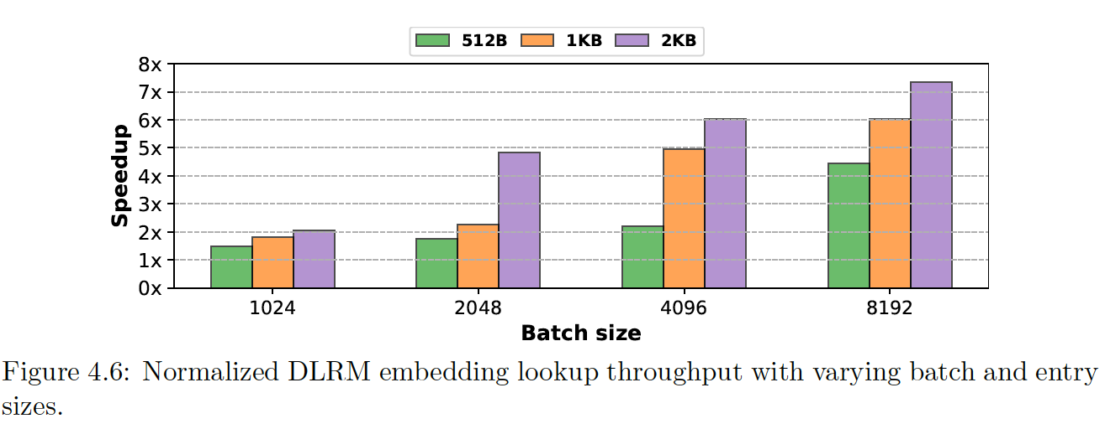
DLRM embedding transfers
Notes:
We also look at transferring large DLRM embedding tables using a library by ColossalAI which transfers between CPU and GPU. We get significant improvements since IBP transfers using the GPU, while the library uses the CPU to handle transfers.

Slide 29
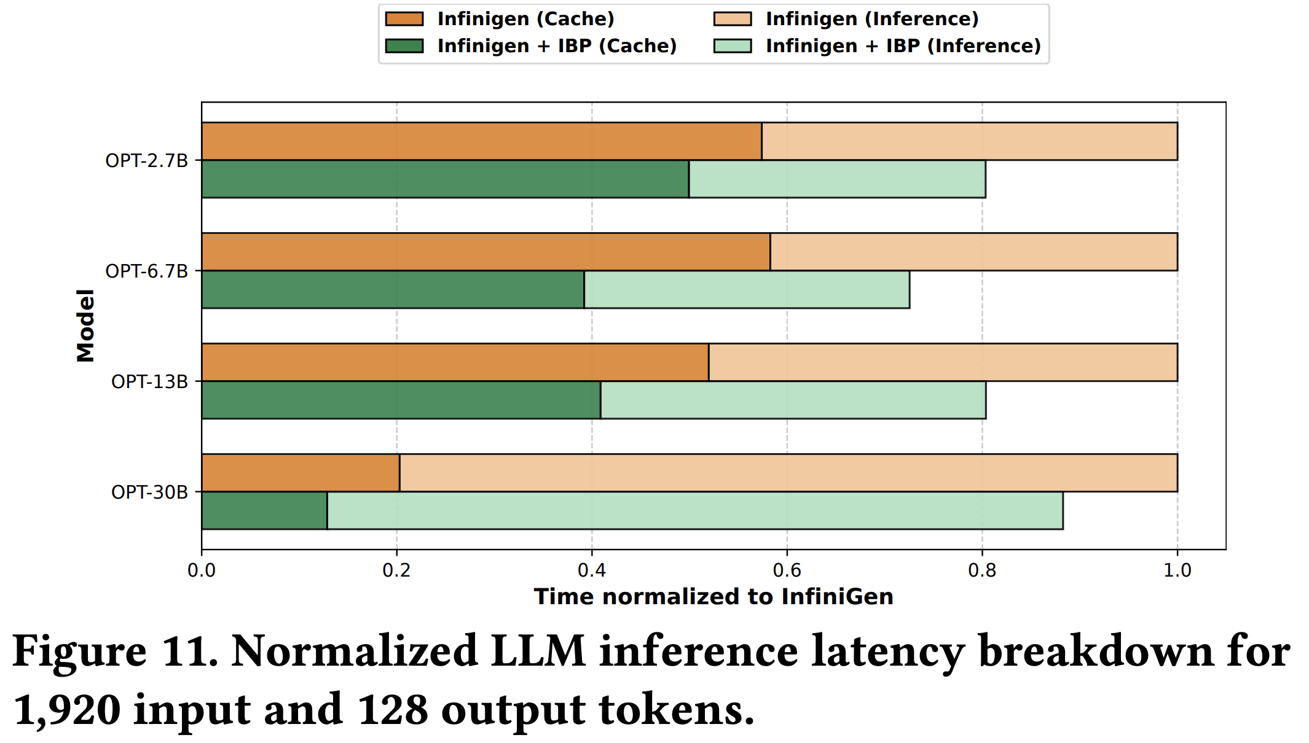
LLM inference
Notes:
We also look at transferring large DLRM embedding tables using a library by ColossalAI which transfers between CPU and GPU. We get significant improvements since IBP transfers using the GPU, while the library uses the CPU to handle transfers.

Slide 30
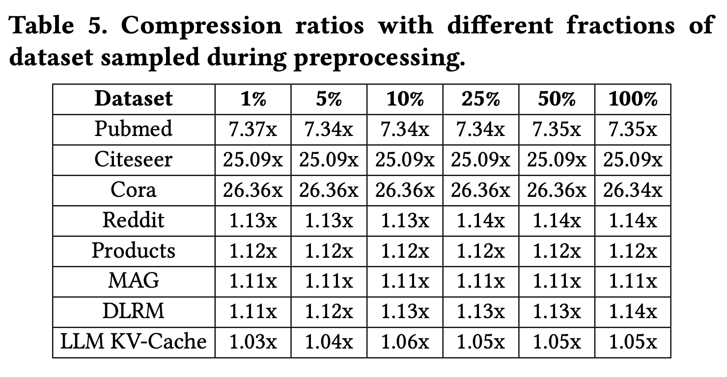
Subset sampling for preprocessing

Slide 31
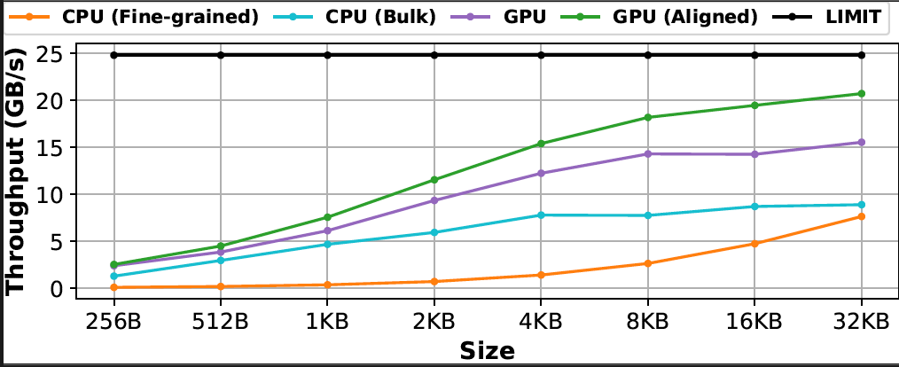
Throughput of various PCIe transfer methods

Slide 32
Observation: Bit positions have different entropies
Signed Int16 representation
Low
entropy
High
entropy
0
0
0
0
0
0
0
0
0
0
0
1
1
0
1
1
Sign
Higher
order bits
LSB
FP16 representation
Low entropy
High entropy
0
0
0
0
0
0
0
0
0
0
0
1
1
0
1
1
Sign
Exponent
Fraction
Notes:
We observe that not all bits are the same. Bit positions have different levels of entropy, that is, randomness in bit values. For example, in integers, the higher order bits tend to have a value 0, while the lower order bits can be 0 or 1, with equal frequency. The higher order bits thus have less entropy, while the lower order bits have more.
Similarly in fp16, the exponent bits tend to have similar values, while the fractional bits have high entropy.

