Slide 1
Mitigating the Impact of
Data Movement in
Memory-Intensive Applications
Aditya K Kamath
University of Washington
Notes:
Hey everyone, I’m Aditya, and I’m presenting my work on mitigating the impact of data movement in memory-intensive applications

Slide 2
Published works for this talk
[ISCA ‘24] “(MC)²: Lazy MemCopy at the Memory Controller” ACM/IEEE 51st Annual International Symposium on Computer Architecture
[ASPLOS ‘25] “POD-Attention: Unlocking Full Prefill-Decode Overlap for Faster LLM Inference” 30th ACM International Conference on Architectural Support for Programming Languages and Operating Systems
[EuroSys ‘26] “Reducing the GPU Memory Bottleneck with Lossless Compression for ML” 21st ACM European Conference on Computer Systems
Notes:
I’m basing this talk off of three published works. (MC)^2 published at ISCA 2024, POD-Attention published at ASPLOS 2025, and a EuroSys 2026 paper.

Slide 3
The “Memory Wall”
Term coined in the 1990s:
Describes gap between processor and memory performance
Managed by techniques like prefetching, speculative execution, and multiple levels of SRAM caches.
Data
Movement
Processor
(CPU/GPU/XPU)
Notes:
In the 1990s, the term Memory Wall was coined to describe the growing gap between processor and memory performance. [click] Processor techniques like prefetching, out of order execution, and multiple levels of fast SRAM caches helped mitigate this problem for a while.

Slide 4
Data movement problems continue to grow
Memory intensity continues to grow with application scale:
  ML deals with hundreds of GBs to TBs scales of data processing on accelerators
  DBs process tabular data at similar scales on the CPU
Data movement is more complex and reliant on a myriad of:
  Intermediate interconnects (PCIe, NVLink, InfiniBand)
  Memory technologies (HBM, CXL)
Data movement causes latency spikes, throughput reduction, and processing bottlenecks.
Notes:
However, the problem never really disappeared. [click] We find that modern applications are dealing with increasingly larger scales of data. ML and databases both manage hundreds of gigabytes to terabytes of data. These scales exceed the largest cache capacities, and even memory capacity.
[click] This leads to reliance on intermediate interconnects like PCIe or Infiniband to move around data, and more complex memory technologies like HBM and CXL to handle the scale of demand.
[click] The problem of data movement is significant as it’s the source of latency spikes, throughput reduction, and processing bottlenecks.

Slide 5
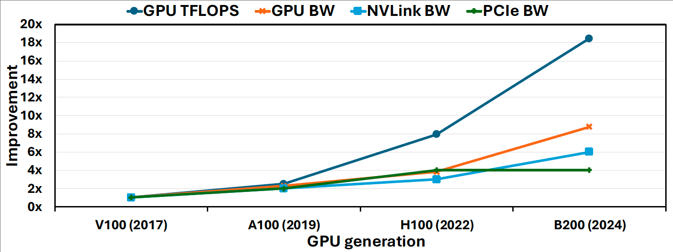
Cause: Throughput chasm
Compute throughput outpaced memory bandwidth by 2X!
For interconnects, compute outpaces by 3 - 5X!
Similar trends observed in CPU:
“AI and Memory Wall”, IEEE Micro 2024
“Databases in the era of memory-centric computing” CIDR 2025
Notes:
To concretize this discussion, we looked at the top-of-the-line server-class GPUs and their supporting interconnects. We looked at how their normalized performance varied over time. [click] We find that compute outpaces the memory bandwidth by 2x. [click] Compute outpaced interconnects by 3 – 5x.
This shows how the wall has in no way disappeared, and instead multiple walls have emerged as applications scale out, causing a throughput chasm.
[click] This problem is not unique to GPUs and have been seen for CPUs by other work as well.

Slide 6
Bottlenecks exist at all levels
Remote Nodes
CPU
GPU
Other GPUs
Network
NVLink
Memory
Memory
PCIe
Disk
Notes:
This diagram depicts a server having CPUs, accelerators like GPUs and their respective memory, disk, a network connecting to remote nodes, and NVLink connecting GPUs.

Slide 7
Bottlenecks exist at all levels
Remote Nodes
CPU
GPU
Other GPUs
Network
NVLink
Memory
Memory
PCIe
Disk
BOTTLENECKS!
Notes:
Due to the throughput chasm, any of these connecting links can become a data movement bottleneck due to performance limitations relative to compute.

Slide 8
Bottlenecks for this talk
CPU
GPU
Memory
Memory
PCIe
BOTTLENECKS!
Notes:
In this talk, I focus the attention to three specific bottlenecks: CPU memory, GPU memory, and the PCIe links connecting them.

Slide 9
Data movement mitigations
Mitigations must be formed taking advantage of application characteristics
We propose a taxonomy of mitigations:
Avoiding data movement
Hiding data movement
Reducing data movement
Notes:
To manage this issue, we need mitigations that take advantage of application characteristics that support them.
We prescribe three complementary techniques that can address bottlenecks across the hierarchy, namely avoiding, hiding, and reducing data movement. This taxonomy allows us to both identify application properties that enable mitigations, as well as give us an idea of how to take advantage of them for performance improvement.

Slide 10
Avoiding data movement
Examples: zero-copy frameworks, caching, copy-on-write
Notes:
First, we should try to avoid data movement. [click] This requires identifying movement that isn’t strictly necessary, and providing alternative paths that preserve the guarantees provided (e.g., data isolation guarantees). Examples are zero-copy frameworks where new API and functions are created to avoid unnecessary copying, caching where data is brought closer to the processor to avoid data movement for frequently accessed data, and copy-on-write, where unnecessarily copying data is avoided until memory pages are written to.

Slide 11
Hiding data movement
Examples: prefetching, OoO execution, compute-communication overlap
Notes:
When data movement cannot by avoided, we should try to hide it. [click] This is done by overlapping it with other concurrent operations (typically compute) so that transfer overhead is removed from the critical path. Examples of this are prefetching where you pre-emptively bring data in before it is needed while other operations are ongoing, out of order execution where memory and compute operations are overlapped, or compute-communication overlap where data is broken into batches and some batches undergo computation while others are transferred.

Slide 12
Reducing data movement
Examples: quantization, model sparsification, data compression
Notes:
After avoiding and hiding whatever movement is possible, we finally try reducing data movement. [click] This involves identifying patterns in data that can be exploited to reduce the volume of data transferred, examples being quantization where high precision data is mapped to smaller data types, model sparsification where low impact weights are removed from a model or data compression where repeated patterns or trends are taken advantage of to reduce data size

Slide 13
Taxonomy of mitigation techniques
1) Avoid
2) Hide
3) Reduce
Notes:
In this talk, I present avoiding, hiding, and reducing data movement as a taxonomy for mitigating the impact of data movement in memory-intensive applications. This targets bottleneck layers in the memory hierarchy through mitigations that exploit specific application characteristics.
I shall discuss three projects I have undertaken in my PhD that exemplify each of these techniques. Even though each project is used to describe a specific mitigation type, they ultimately use a mix of these techniques.
I show improvements for databases, inter-process communication, and machine learning workloads.

Slide 14
CPU memory bottleneck
CPU
GPU
Memory
Memory
PCIe
CPU DRAM’s limited BW and high latency causes stalls when copying data
Notes:
First, we shall target the CPU memory bottleneck which causes CPU stalls when copying data due to the DRAM’s limited bandwidth and high latency.

Slide 15
Avoid: Lazy MemCopy for Databases and IPC
Published as:
(MC)²: Lazy MemCopy at the Memory Controller, ISCA 2024
Notes:
I discuss (MC)²: Lazy MemCopy at the Memory Controller, which makes use of the avoid technique by providing a lazy memcpy operation to improve database and IPC performance

Slide 16
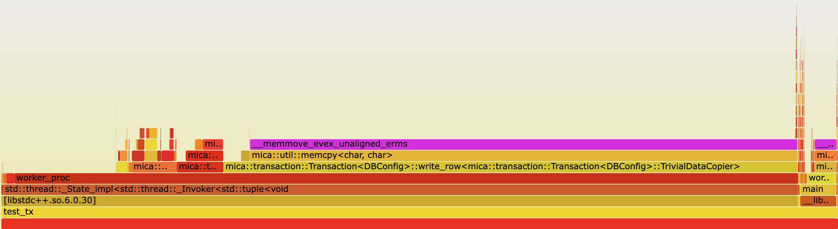
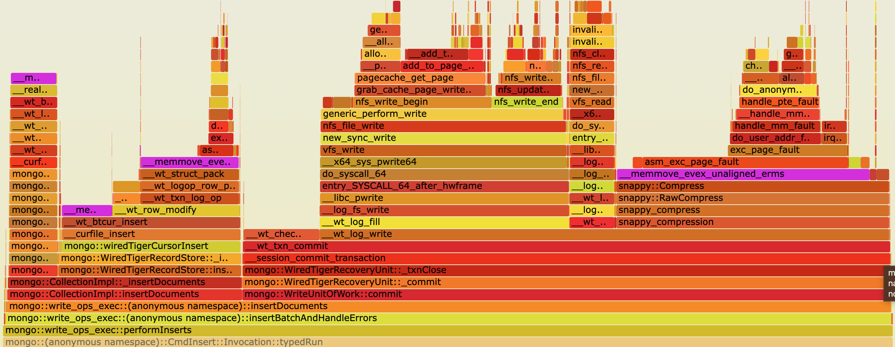
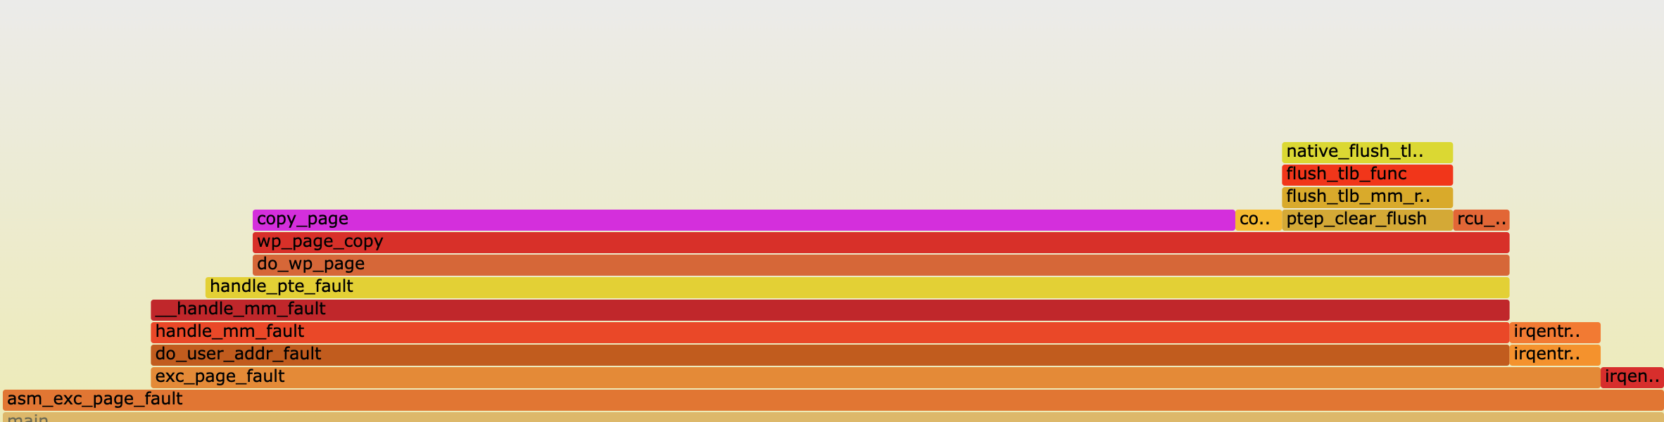
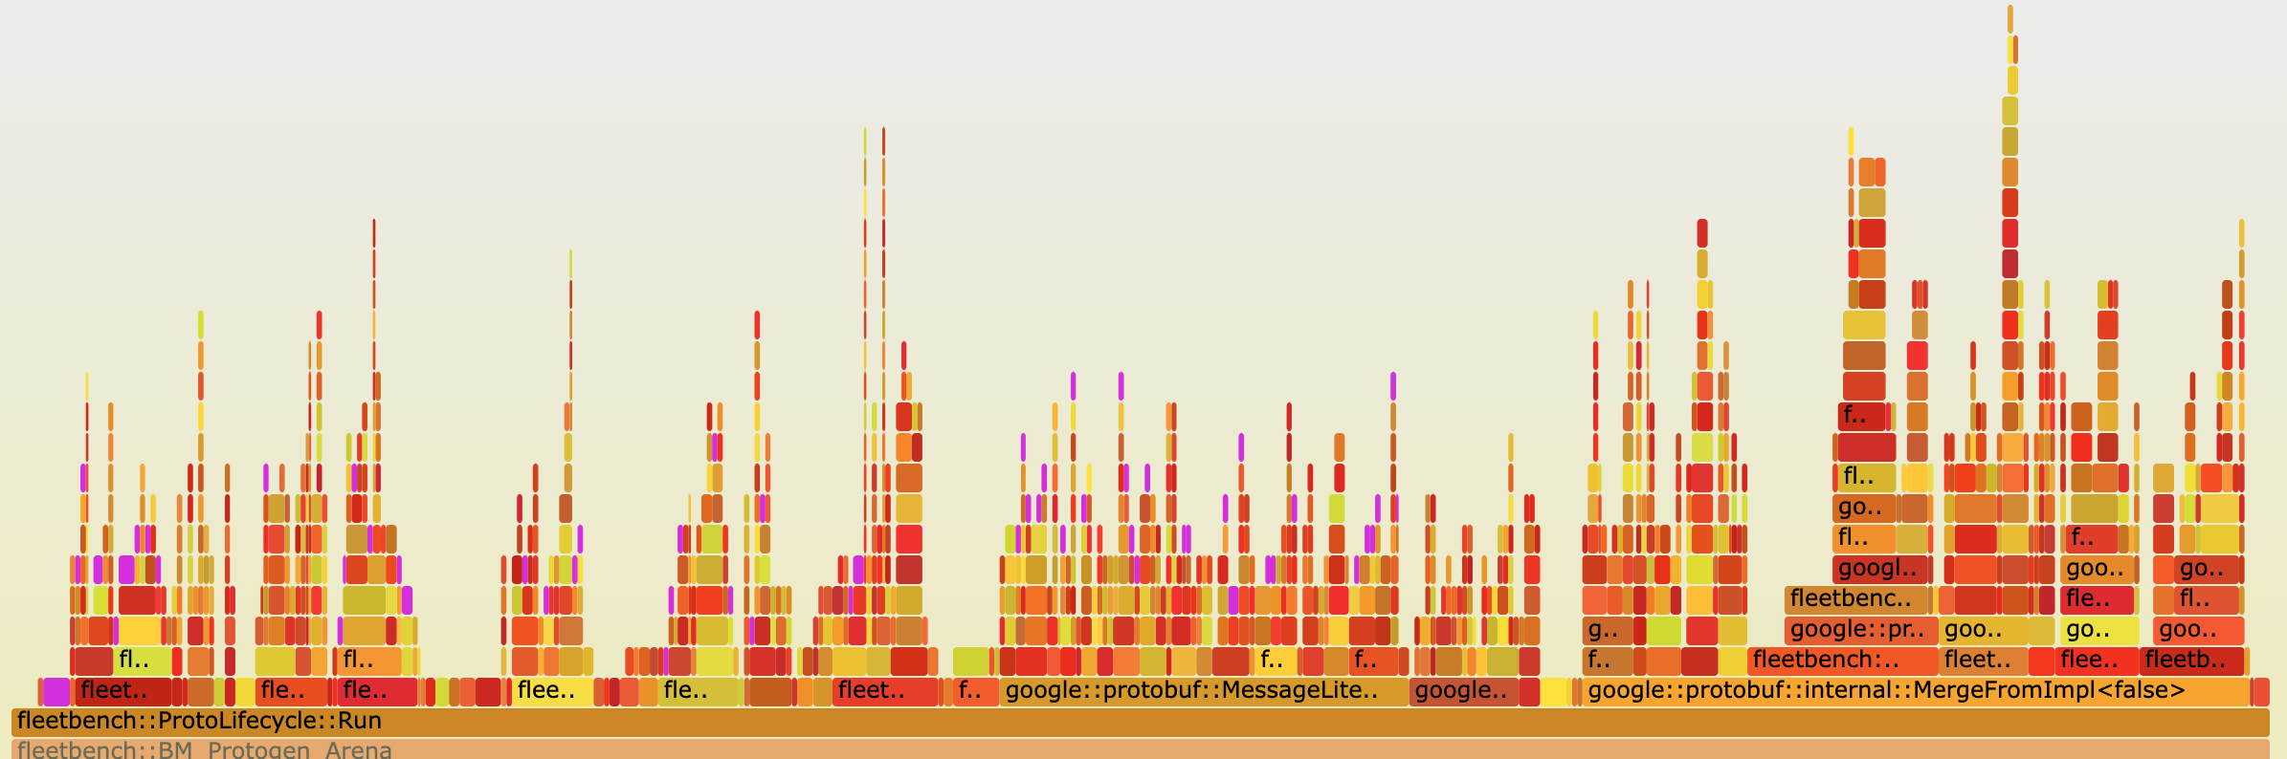
Operations with high copy overhead
Cicada [1] writes: 68.0%
MongoDB [2] inserts: 42.3%
Fork + COW fault: 60.0%
Protobuf (Serialize/Merge) [3]: 29.2%
[1] H. Lim et al., SIGMOD ’17 [2] github.com/mongodb/mongodb [3] github.com/google/fleetbench
Notes:
We conducted a study on several operations across different application domains that exhibited a high copy overhead.
We plotted flamegraphs showing the amount of time spent in various functions of these operation, including memory copy times.
The top two graphs depict writes and insertions for an OLTP and NoSQL database respectively.
While the bottom left graph shows OS copy-on-write faults, and the bottom right shows common Protobuf operations.
The bars highlighted in purple show the time spent copying, which can be up to 68% for these operations. We found that the major cause of this copy overhead was cache misses forcing data to be fetched from memory.

Slide 17
Insights from studying use-cases
Apps often use memory copies to fill temporary buffers
Copies may be excessive/redundant if full copy isn’t accessed
Killer microseconds: difficult for CPU to hide copy overhead
Notes:
Our insights from looking at these applications are that they typically use memory copies to fill temporary buffers. This can lead to excessive or redundant copying.
When copying happens in the critical path of the application processing, it becomes difficult for the CPU to hide its overhead, leading to ”killer microseconds” of copy execution

Slide 18
Use case: Read-Copy-Update in MVCC databases
Writer
Write X
Write Y
Commit
Read Y
Read X
Commit
Reader
Copy
Database
Copy used for isolation
Notes:
To see how copies are used in these applications, let’s look at a typical use case: read-copy-updates in multi-version concurrency control databases.
MVCC databases copy rows or tuples being modified to local buffers to preserve isolation guarantees. In this example, we see two threads performing transactions on the database concurrently, with one writer and one reader.
[click] Before performing the modifications, the writer creates a copy of the row that it wishes to modify.
[click] The writer then performs its required modification to its local copy.
[click] This allows the reader to read the unmodified data from the original database and avoid inconsistencies in its operations.
[click] When the writer commits the transaction it merges its row back into the main database. The entire row may not end up modified, in which case the writer copied more data than it actually needed to.

Slide 19
Current systems: Eager copying
Copy Src to Dest
Read
Dest[1]
Dest[1]
Dest
Src
Notes:
Currently, applications make use of what we refer to as “eager copying” [click] where a copy operation causes data to be moved.
[click] Then on access, the required data is obtained.
For the applications we analyzed, we found that this is not the best approach for data movement.

Slide 20
Our proposal: Perform movement lazily
Copy Src to Dest
Read
[Don’t copy]
Dest[1]
Dest[1]
Dest
Src
Notes:
We instead propose performing data movement lazily.
[click] On a copy operation, we don’t do anything.
[click] When the data is accessed, we reroute the request to the appropriate location performing the data copy.
This method only copies data that is accessed, avoiding unnecessary copies. Furthermore, it allows the hardware prefetcher to trigger copies before data is accessed to hide copy latencies.

Slide 21
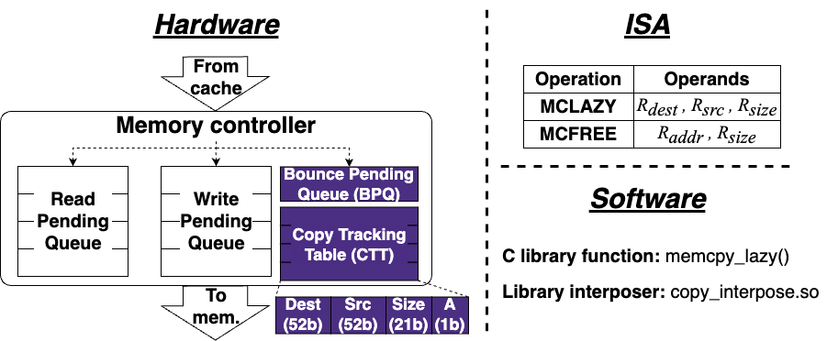
(MC)² : Lazy MemCopy at the Memory Controller
Notes:
To support this operation, we propose MC^2, performing lazy memcopy at the memory controller.
On a lazy copy operation, a message is sent to the memory controller which keeps track. On a memory access, the memory controller reroutes the request to the appropriate location.
We find that the memory controller is the ideal place to handle this as all memory accesses must pass through it, and it frees up responsibilities from the CPU, providing opportunities for copy hiding.
This system consists of three main components. Hardware modifications to the memory controller which are shown in purple, new instructions, and a software wrapper

Slide 22
Evaluation questions
How much lower is (MC)²’s copy overhead?
What is the impact of lazily copying data on access time?
What benefit could (MC)² provide real workloads?
What are the sources of overhead for (MC)²?
How do (MC)²’s various parameters impact performance?
Notes:
We now have a few questions that we shall quantify in our evaluation.
How much lower is MC^2’s copy overhead? What impact does it have on access times? and what benefit could (MC)^2 provide real workloads?
In our full paper we answer a few more questions that we wont be able to cover here.

Slide 23
Evaluation: GEM5 configuration
Hardware
CPUs | 8 | 8 | Clock speed | 4 GHz
Private L1 cache | 64 KB/CPU, stride prefetcher | 64 KB/CPU, stride prefetcher | Shared L2 cache | 2 MB, stride prefetcher
DRAM size | 3 GB | 3 GB | DRAM channels | 2
DRAM config. | DDR4 | DDR4 | BPQ size | 8 entries
CTT entries | 2048 | 64K | CTT latency | 0.79 ns
Software
OS kernel |  | Linux 5.7.0 | Distribution | Ubuntu 20.04
Notes:
To answer these questions, we make use of gem5, a cycle-accurate CPU simulator.
Our configuration models a scaled-down server node with 8 CPUs.

Slide 24
Evaluation: Prior work comparison
Prior work: zIO [1], OS-based COA | Our proposal: (MC)², lazy copy
Software-based | Hardware-based
Page-granularity | Cacheline-granularity
Requires TLB shootdowns | No shootdowns required
High access penalties | Minimal access penalties
[1] T. Stamler et. al., ODSI ‘22
Notes:
Wherever possible, we compare against zIO an OS-based copy-on-access mechanism that makes use of OS-managed page tables to elide copies.
zIO is essentially the OS-based approach to lazy copying, which requires expensive page table management operations on accessing lazily copied pages, giving it high access penalties.

Slide 25
Evaluation: Copy performance
11x
faster!
Faster
Notes:
To evaluate the latency of copying, we performed an experiment where different sized source buffers were copied to destination buffers. Note the y-axis is in log scale.
We evaluate against memcpy in two scenarios. The first is where none of the data is cached referred to as just Memcpy, the second is where the source and destination buffers have been accessed just before the copy allowing them to be cached. These are essentially the best- and worst-case performance for memcpy. Copies with high overheads behave closer to the uncached memcpy performance.
[click] (MC)^2 provides speedups for copies at and above 1 KB, performing similar to copying cached data at 64 KB and above, and is up to 11 times faster than uncached memcpy.
[click] Since zIO relies on page table manipulation, it only ran for copies at and above a 16KB size. It has a high initial overhead due to page table manipulation and TLB shootdowns. Below 256KB, MCSquare outperforms zIO. Above this, zIO outperforms (MC)^2 as (MC)^2 relies on cacheline flushing which has its own overhead. Despite this, we shall see how (MC)^2 still provides benefits at these sizes.

Slide 26
Evaluation: Copy + access runtime
Faster
Notes:
To analyze the impact of lazily copying on access latencies, we ran a microbenchmark where a 4 MB source buffer is copied to a destination buffer. The destination is then accessed sequentially.
We intentionally misaligned the source and destination, as in the applications we examine, the source and destination buffers are typically not cacheline-aligned with each other.
For our system this causes additional access latencies to fetch data (full details in the paper).
The runtime of each system is normalized to the time taken by memcpy, with higher meaning slower. We analyze the runtime when different percentages of the 4 MB destination buffer are accessed.
As we previously saw, zIO outperforms (MC)^2 when the dataset isn’t accessed. However, once we start accessing the destination, zIO starts seeing page faults triggering copies. When more than 25% of the dataset is accessed it starts performing worse than memcpy.
On the other hand, (MC)^2 is able to retain low latency penalties.
Surprisingly, even when the entire dataset is accessed, MC^2 outperforms memcpy. We find that this is because the cache prefetcher hides some of the extra access latencies. [click] When we turn off the prefetcher, we see that it slows down compared to memcpy, showing the impact of copy latency hiding.
[click] When the source and destination are aligned, we see even better performance.

Slide 27
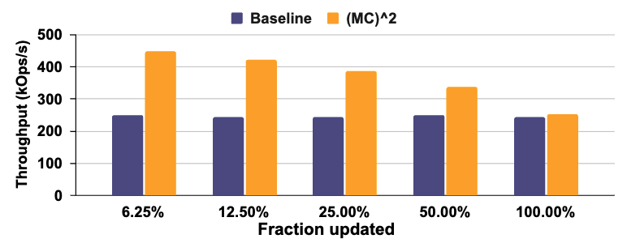
Evaluation: Cicada transaction throughput
Faster
Notes:
Moving on to the performance of applications with MCSquare, we see that many database transactions involve updating only small portions of a tuple. For example, in TPCC, decrementing the quantity of stock of an item being sold in a store may only update 1 – 2 % of the total tuple size. As we previously saw, this leads to excessive data being copied for the read-copy-update performed by MVCC databases.
With (MC)^2, we can pay only the copy overhead for the portion of the tuple updated.
To evaluate this, we enhanced the Cicada database with (MC)^2 and performed repeated operations on a table with 8KB sized rows modifying different fractions of the tuple and measuring throughput. These operations are split 50:50 between reads and updates typical of write-intensive DB workloads. We used 8 threads saturating the cores on our system.
(MC)^2 is able to provide up to 78% higher throughput, since it reduces the memory bandwidth consumed for smaller update fractions.

Slide 28
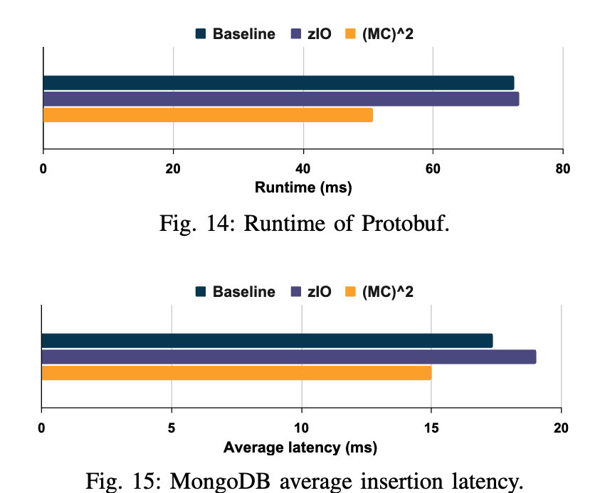
Evaluation: Protobuf and MongoDB
Faster
Faster
43% lower
15% lower
Notes:
We analyze (MC)^2 with a protobuf workload provided in Google’s Fleetbench benchmark suite. Fleetbench contains workloads dedicated to common hot library functions, constructed using traces from production servers. We find that (MC)^2 has 43% lower runtime compared to memcpy. zIO is unable to generate any performance benefit since all the copies in this benchmark were smaller than the 4 KB page size it requires to elide copies.
We also replicated an experiment from the zIO paper, where MongoDB insertions are performed using 100KB fields and 10 fields per insertion. (MC)^2 provides on average 15% lower latency for insertion, while zIO slows down by 9%. This is because copied data is later accessed, triggering page faults for zIO which (MC)^2 avoids.
Our paper contains more evaluation for workloads including huge page COW faults, and kernel buffer copying.

Slide 29
(MC)² highlights
Up to 11x faster than standard memcpy
Simulation results using GEM5 indicate:
  43% speedup in a Protobuf benchmark
  15% faster insertion operations in MongoDB
  Up to 78% higher throughput for MVCC databases
Our code is available: https://github.com/AKKamath/MCSquare-ISCA24
Notes:
As a summary, we introduce MCSquare a novel lazy copy mechanism at the memory controller, which provides up to 11x faster copying than standard memcpy. We simulated it using GEM5, a cycle-level CPU simulator. It provides benefits across workloads such as Protobuf, MongoDB, and MVCC databses. Our code is completely open-source on Github.

Slide 30
GPU memory bottleneck
CPU
GPU
Memory
Memory
PCIe
Limited GPU memory bandwidth harms LLM performance
Notes:
Now, we target the GPU memory bottleneck where limited GPU memory bandwidth causes issues during LLM inference

Slide 31

Hide: Operation Overlap for LLM Inference
Published as:
POD-Attention: Unlocking Full Prefill-Decode Overlap for Faster LLM Inference, ASPLOS 2025
Notes:
I now discuss POD-Attention, which makes use of the [click] hide technique by overlapping memory-bandwidth intensive decode operations with compute-intensive prefill operations in LLM attention.

Slide 32
LLM prefill
Time-To-First-Token (TTFT)
Time taken by this iteration
decode
Feed-Forward Network
Prefill
Large input size
N Layers ⨉
Self-Attention
This
Is
A
Prefill
Large Language Model (LLM)
User
Notes:
Large Language models or LLMs are extremely popular today. (click) The fundamental unit of LLM architecture is the transformer block which consists of Self Attention and the Feed Forward Network. This block repeating N times makes a large language model. (click) When a user submits a prompt, the LLM processes it to produce the first token. This is called prefill. (click) The time that this takes is called the Time to first token, which is an important latency metric that modern LLM serving systems try to optimize.

Slide 33
LLM decode
Time-Between-Token (TBT)
Time between two decodes
decode
is
happening!
Feed-Forward Network
Decode
Single token input/output size.
N Layers ⨉
Self-Attention
This
Is
A
Prefill
decode
is
Large Language Model (LLM)
User
Notes:
After the first iteration, the output is passed back into the LLM to generate the next token. This is called a decode. (click) It is characterized by its relatively smaller input and output size. (click) This process of passing new tokens back to the LLM continues until it stops generating tokens for the request. (click) The time between two decodes is called Time between token or TBT, which is another important latency metric that serving systems optimize for.

Slide 34
LLM hybrid batching [Sarathi-Serve, OSDI’24]
Prefill
Prefill
LLMs
Decode
Decode
Prefill and decode inputs of multiple requests are combined as a single input
Improves throughput by reusing model weights reducing latencies.
Notes:
Hybrid batching has emerged as the state-of-the-art method of balancing these latencies in single-node deployments. [Click] In hybrid batching, multiple requests’ prefill and decode are combined and operated on by the same model weights. This improves overall throughput by reusing model weights and reduces latencies.

Slide 35
LLM hybrid batching: A closer look
Layer norm
Pre-projection
Post-projection
Layer norm
FFN
Prefill
Prefill
Attention
Decode Attention
Decode
Notes:
[click] When we take a closer look at how hybrid batching is implemented in frameworks, we see that the reuse of model weights does happen for operations like Pre projection.

Slide 36
LLM hybrid batching: A closer look
Prefill
Prefill
Layer norm
Pre-projection
Decode
Post-projection
Layer norm
FFN
Decode
Prefill
Attention
Decode Attention
Prefill
Decode
Attention operates on discrete data items (no data reuse across input requests).
Kernels optimized independently for prefill or decode.
Notes:
Unfortunately, for Attention operations, each input is operated on by a separate data item called a KV-Cache which isn’t shared across the requests. GPU attention kernels are independently optimized for either prefill’s large size or decode’s small size. [Click] This means that the inputs are separated and the attention for each is performed independently, following which they are again recombined for the rest of the LLM layer.

Slide 37
Why optimize attention?
60% of overall time
Model: Llama-3-8B, Hardware A100 x 2, Decode Batch Size: 60
Attention is the biggest bottleneck at large context lengths
Notes:
Our motivation is that as the context lengths or number of tokens increases, the attention operations end up being the biggest bottleneck, taking up to 60% of execution time as shown in the plot here. As context lengths are ever-increasing, this problem will only increase in magnitude. For the rest of this talk we’ll focus only on Attention. We now look at the opportunities present for improving this situation.

Slide 38
Opportunity: Resource (under)utilization
Model: Llama-3-8B, Hardware: 2 A100
Prefill saturates compute but has low memory bandwidth utilization.
Decode saturates memory bandwidth but has low compute utilization.
Notes:
We profiled the prefill and decode attention kernels to identify the compute and memory bandwidth utilization shown in the y-axis. As prefill attention operates on a large number of tokens seen in the x-axis, prefill attention kernels are optimized for large matrix multiplications which are compute-bound. For decode attention, typically 10 to 100 requests are batched together and operated on, which have a small number of tokens compared to prefill. The decode kernels are optimized for smaller matrix multiplications which are memory-bound.
[click] We notice that the utilization of memory bandwidth for prefill was below 5% and compute for decode was below 10% which is very low. From this we ask, is it possible to saturate both the compute and memory bandwidth by performing these operations together?
To answer this question, we must first look at how the GPU processes operations.

Slide 39
GPU execution: CTA scheduling
CTA
Launched Kernel
Stream
queue
CTA
CTA
CTA
CTA
CTA
CTA scheduler
SM
SM
SM
CTA
CTA
CTA
L1 $ / Shared mem
L1 $ / Shared mem
L1 $ / Shared mem
GPU
L2 $
DRAM
CTA scheduler in hardware assigns queued CTAs to SMs for execution.
Notes:
When a programmer launches a GPU kernel, they specify groups of a hundred to a thousand threads called Cooperative Thread Arrays or CTAs. The work to be done by the kernel is split among these different CTAs. For example, in tiled matrix multiplication, each CTA can handle a different matrix tile. [click] These wait in a stream queue until a CTA scheduler assigns these CTAs to the Streaming Multiprocessors or SMs within the GPU where execution occurs. The SM is analogous to a CPU processor. For the attention kernels we analyzed, each SM held 2 CTAs.

Slide 40
GPU execution: Warp scheduling
SM
CTA
CTA
Warp
Warp
Warp
Warp
Warp
Warp
Green = Prefill Warp
Orange = Decode Warp
Warp scheduler
Compute core
Compute core
Ld/st unit
Ld/st unit
L1 $ / Shared mem
Warp scheduler assigns queued warps to free resources attempting to saturate all GPU resources.
Notes:
Inside the SM, these CTAs are divided into warps, [click] which are groups of 32 threads which execute in lockstep. In the figure, we look at the warps of a decode kernel which are memory-bound, depicted with an orange color. A warp scheduler assigns queued warps to free resources every clock cycle. If possible, it attempts to saturate all the available resources. [click] For the decode attention shown, these warps are all reliant on the load/store unit to perform memory accesses. [click] As all the warps are contending for the same resource, the warp scheduler has limited opportunity to overlap execution between the warps. Conversely, prefill warps are compute bound and contend for the compute cores.
[click] If instead, we had prefill warps co-located with these decode warps within the same SM, the warp scheduler could attempt to service them all in parallel as depicted, thus improving overall throughput.

Slide 41
Fusing prefill and decode
Goal: Overlap compute-heavy prefill with memory-bandwidth-heavy decode to fully utilize GPU resources.
  Sub-Goal: Co-locate prefill and decode warps within the same SM.
Notes:
Thus, to achieve the best performance and reach our goal of overlapping compute-heavy prefill with memory-bandwidth-heavy decode. [click] We establish a new goal of co-locating the prefill and decode CTAs within the same SM so that the warp scheduler can overlap them.

Slide 42
Known methods of kernel fusion
Naïve fusion (CTA-parallel): Combined kernel for both prefill and decode.
Kernel-parallel: Launch kernels in separate CUDA Streams.
Warp-parallel: Divide warps in the CTA among ops [HFuse, CGO ‘22].
Intra-thread: Every thread performs both operations.
Cannot guarantee operation co-location within SM.
Exhibits bad load balancing within the GPU.
Excessive synchronization overhead.
Notes:
For this, we go over existing methods of kernel fusion and find that they all have limitations. (click) Naïve fusion and kernel parallel cannot guarantee operation co-location within an SM, and we shall shortly see why. Warp-parallel execution exhibits bad load balancing within the GPU. Intra-thread fusion requires excessive synchronization overheads for correctness.

Slide 43
Naïve kernel fusion (CTA-parallel)
CTA
CTA
CTA
CTA
Stream
queue
CTA
CTA
Green = Prefill CTA
Orange = Decode CTA
CTA
CTA
CTA
CTA
CTA scheduler
SM
SM
SM
CTA
CTA
CTA
CTA
CTA
CTA
L1 $ / Shared mem
L1 $ / Shared mem
L1 $ / Shared mem
Cannot guarantee SM co-location, limiting speedup.
Notes:
The traditional method of kernel fusion involves combining the two kernels into one kernel, assigning the different CTAs to different operations. In the figure the green CTAs perform prefill and the orange decode. (click) The problem with this approach is that since the CTA scheduler is handled by hardware, there is no control over which CTAs get scheduled on which SMs greatly limiting the speedup. Kernel-parallel execution suffers from the same problem for the exact same reason.

Slide 44
How can we address this?
Goal: Overlap compute-heavy prefill with memory-bandwidth-heavy decode to fully utilize GPU resources.
Problem: CTA scheduler is handled by GPU driver/hardware.
Notes:
We see that a major problem of fusion is that the assignment of CTAs to GPU SMs is hidden from the programmer as it is handled by the GPU driver and hardware.

Slide 45
Introducing POD-Attention!
POD-Attention: Combines prefills and decodes into a single kernel with guaranteed SM co-location.
Key idea: SM-aware CTA scheduling
  Guarantees each SM runs prefill and decode CTAs in parallel.
  Enables the warp scheduler to overlap the two operations.
  Utilizes compute and memory bandwidth simultaneously.
Notes:
To address this, we introduce POD-Attention, which efficiently combines prefill and decode operations into a single kernel while guaranteeing SM co-location. POD-Attention uses SM-aware CTA scheduling to guarantee co-location of prefill and decode within each SM. This allows the warp scheduler to overlap the operations and properly utilize both the compute and memory bandwidth of the GPU. Unlike other approaches, we can guarantee SM co-location as well as good load balancing.

Slide 46
POD-Attention: Fused kernels
CTA
CTA
POD-Attention
stream
Green = Prefill CTA
Orange = Decode CTA
CTA
CTA
Prefill
stream
Decode
stream
CTA
CTA
CTA
CTA
CTA
CTA
CTA scheduler
SM
SM
SM
L1 $ / Shared mem
L1 $ / Shared mem
L1 $ / Shared mem
We create a new kernel with enough CTAs for both prefill and decode kernels.
Notes:
Previously, we would launch two kernels, one for prefill and one for decode, each with a certain number of CTAs depending on the inputs. (click) With POD-Attention, we instead have a new kernel which is launched with enough CTAs for both prefill and decode combined.

Slide 47
POD-Attention: SM-aware CTA scheduling
CTA
CTA
POD-Attention
stream
CTA
Green = Prefill CTA
Orange = Decode CTA
CTA
CTA
CTA scheduler
SM 0
SM 1
SM 2
CTA
CTA
CTA
CTA
CTA
L1 $ / Shared mem
L1 $ / Shared mem
L1 $ / Shared mem
2
1
2
3
2
SM counter array
Prefill counter
Decode counter
Notes:
Instead of having dedicated prefill and decode CTAs, we treat all of the CTAs the same before execution begins. Inside the kernel, we maintain three global variables shared by all the CTAs, namely (click) the SM counter array, (click) the prefill counter, and the decode counter. The SM counter array keeps track of how many CTAs have launched on each SM so far. In the figure we see that the counter array has 2, 1, and 2 which means 2 CTAs have run on SM 0, 1 on SM 1, and 2 on SM 2. The prefill and decode counters keep track of how many CTAs have executed prefill and decode respectively. In the figure we see the prefill counter contains 3, indicating 3 prefills have executed, while the decode counter has 2 matching the 2 decode CTAs. We shall now look at how these allow us to co-locate prefill and decode operations despite having no control over the hardware CTA scheduler.

Slide 48
POD-Attention: SM-aware CTA scheduling
CTA
Read SM ID hardware register
Atomically increment SM counter to find which op to perform
Atomically increment op counter to get CTA_ID
Begin operation
CTA
POD-Attention
stream
CTA
CTA
CTA
CTA scheduler
SM 0
SM 1
SM 2
CTA
CTA
CTA
CTA
CTA
CTA
CTA
L1 $ / Shared mem
L1 $ / Shared mem
L1 $ / Shared mem
2
1
2
2
3
3
2
SM counter array
Prefill counter
Decode counter
Notes:
Once a CTA is launched by the CTA scheduler onto an SM, it first determines the SM it was launched on by reading an SM ID hardware register contained within every SM. In the shown case, the newly launched CTA reads the SM ID 1. [click] It then increments the SM counter array for the respective SM, getting the value 1 from the counter array, and replacing it with 2. This informs the new CTA that it is the second CTA to launch on that SM, with an ID value of 1. We now apply a policy to decide what operation this newly launched CTA should run based on this value, for example, even numbered CTAs perform prefill, odd CTAs perform decode. [click] In the shown case, since it has a value of 1, it performs decode. [click] The CTA then atomically increments the decode counter and executes it. This allows us to ensure that we don’t run more operations that necessary. For example, if we want only 4 decode CTAs and the counter has the value 4, we can perform prefill instead. [click] Since each CTA determines its operations based on previously launched CTAs within each SM, we guarantee co-location of the different operations. Since each SM can hold two CTAs, load balancing is not an issue as completion of an operation allows another to get scheduled on the SM.

Slide 49
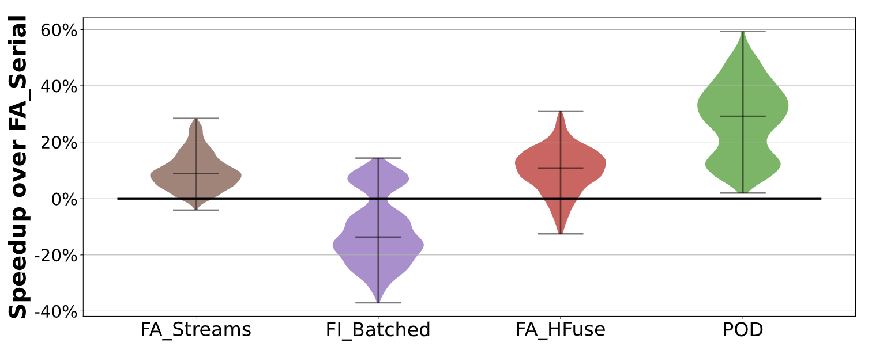
POD-Attention performance
Streams
Batched
HFuse
POD beats all existing alternatives, with up to 59% speedup (28% average).
Notes:
To investigate POD-Attention’s performance, we ran the attention kernels sweeping over a thousand practical input configurations, varying input sizes and LLM model configurations. We compare against FlashAttention kernels, as well as state-of-the-art FlashInfer kernels. FA_Serial, our baseline, executes the two operations in serial, similar to how existing hybrid-batch frameworks run these kernels. Streams executes prefill and decode in separate CUDA streams, as we previously saw. This provides some limited speedup, as early completion of some prefill operations allows decode to start utilizing the GPU. Batched combines both prefill and decode input and runs a single prefill kernel. This ends up usually performing worse, as kernel execution is optimized for one set of inputs (in this case prefill), and adding other inputs leads to subpar execution choices, like excessively large matrix multiplication tile sizes. Hfuse is a state-of-the-art GPU kernel fusion tool that merges the warps of different kernel’s CTAs. Finally, POD performs 29% - 33% better on average, with a speedup of up to 59%.

Slide 50
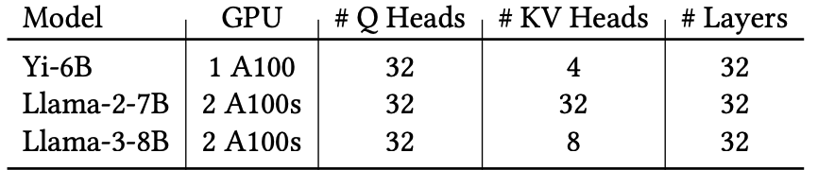
LLM evaluation: Baselines and workloads
Inference frameworks
Framework | Description
vLLM [SOSP ‘23] | Popular framework that prioritizes prefill latency (TTFT).
Sarathi [OSDI ‘24] | Uses hybrid-batching to improve decode latency (TBT).
Sarathi + POD | Sarathi enhanced with POD-Attention.
Models and hardware
Notes:
We also evaluate POD-Attention’s benefit on end-to-end LLM execution. We compare against state-of-the-art schedulers vLLM and Sarathi. vLLM uses prefill prioritizing scheduling which stalls ongoing decodes whenever a new prefill request arrives. Sarathi instead uses hybrid batching which combines prefills and decodes into a batch avoiding these stalls. Finally, we look at Sarathi enhanced by POD to overlap the prefill and decode attention. We evaluate on a few different models on A100 GPUs.

Slide 51
Online inference performance
Llama 3 8B, arXiv-Summarization, QPS = 0.95
Lower is
better
vLLM provides low TTFT but high TBT, stalling nearly all requests
Sarathi provides low TBT, but high TTFT
Sarathi + POD reduces TBT stalls with TTFT closer to vLLM
Notes:
vLLM prioritizes prefills, providing low TTFT at the expense of high TBT. Sarathi’s hybrid batching suffers from high TTFT latency as prefills and decodes are combined in a batch causing decode’s attention latency to have an impact on TTFT. POD allows both to overlap achieving an acceptable latency in comparison.

Slide 52
POD-Attention highlights
POD-Attention fuses prefill and decode attention to maximize GPU resource utilization
Performance improvement:
  Up to 59% faster hybrid attention over current methods
  Up to 22% higher end-to-end throughput
  Lower latency and stalls than state-of-the-art frameworks
Our code is available: github.com/microsoft/vattention/tree/main/pod_attn
Notes:
To highlight, POD-attention fuses prefill and decode attention to maximize GPU utilization. It's able to provide 59% faster attention, with 22% higher end-to-end throughput. Our code is publicly available.

Slide 53
PCIe botleneck
CPU
GPU
Memory
Memory
PCIe
Limited PCIe bandwidth hurts offloading-based ML frameworks
Notes:
Now, we target the PCIe bottleneck where limited bandwidth causes issues for offloading-based ML frameworks

Slide 54
Reduce: Lossless Compression (IBP) for ML
Published as:
Reducing the GPU Memory Bottleneck with Lossless Compression for ML, EuroSys 2026
Notes:
I now discuss Invariant bit packing compression, which makes use of the reduce technique by compressing ML tensors before they’re transferred across the PCIe, reducing the volume of data moved.

Slide 55
The GPU bottleneck in ML
CPU
GPU
…
Memory
Core
Core
PCIe
Memory
Data
Data exceeds GPU
memory capacity
Notes:
Data used by machine learning frequently exceeds the capacity of GPU memory, causing issues during training and inference

Slide 56
The GPU bottleneck in ML
CPU
GPU
…
Memory
Core
Core
Data
PCIe
Memory
Data $
Model
Kept in CPU memory,
transferred as needed
Notes:
To resolve this, machine learning frameworks place the data in the larger CPU memory instead, and a software cache of frequently accessed data is maintained within GPU memory.
[click] Cache misses are then transferred on-demand to the GPU across the PCIe interconnect.

Slide 57
The GPU bottleneck in ML
CPU
GPU
Processing
…
Memory
Core
Core
Data
PCIe
Memory
Data $
Model
Next
transfer
Waiting!
Notes:
This data is then processed on the GPU as before. Since data must be transferred before processing, the PCIe ends up forming the bottleneck, [click] causing the GPU to frequently wait until data reaches it before it can begin execution.

Slide 58
The GPU bottleneck in ML
Models examined across training and inference
CPU
GPU
…
Memory
Core
Core
Data
PCIe
Memory
Large Language Models
(LLM)
Graph Neural Networks (GNN)
Recommendation
Models
(DLRM)
Data $
Model
Waiting!
Notes:
This problem is not unique to a specific ML model. We’ve found that this occurs across ML applications, including graph neural networks, recommendation models, and large language models. It’s prevalent across both training and inference. [click] We ran an experiment using a GNN training framework called Legion on an A100 GPU. This framework overlapped PCIe transfers with training computation. We found up to 70% of the end-to-end training time was spent waiting for the transfers to complete, despite both happening in parallel.

Slide 59
Quantization helps transfers but hurts accuracy
Quantization (lossy compression) is a popular research approach
  Compresses data by 2 – 16x
In practice, difficult to deploy
  Accuracy tradeoff must be tuned specifically to each model
  Still leads to unpredictable changes in model behavior [1]
  Risk of revenue loss (even with 0.1% accuracy drop) [2]
[1] Accuracy is Not All You Need [NeurIPS ‘24]
[2] Understanding training efficiency of deep learning recommendation models at scale [HPCA ‘21]
Notes:
Quantization is a possible technique to relieve this overhead. [click] Quantization can provide an order of magnitude of compression. [click] Unfortunately, quantization has tradeoffs making it difficult to deploy. Model accuracy dips requiring it to be finetuned for each model. Even then, prior work has shown that model behavior can change in unpredictable ways, like LLMs rambling more. The risk of revenue loss can lead to users being hesitant to deploy this.

Slide 60
Lossless compression to the rescue?
Tested lossless compression via 8 SOTA algorithms:
Can provide good space savings
  zStd reduced LLM KV-cache size by ~40%
But often too slow for drop-in use in ML applications
  Especially poor on dense floating-point data (up to 10x slowdown)
Problems:
Large metadata overhead
Multiple memory (often PCIe) accesses for decompressing each data word
Notes:
Instead, we look at whether lossless compression could help.
[click] We examined 8 state of the art GPU decompression schemes to transfer ML data across the PCIe. [click] We found that while they may compress data well, [click] their decompression throughput is poor leading to slowdowns. [click] There were a few different causes. One is that some compression algos use large amounts of memory to store metadata like dictionaries, that scale with the input size. They also require multiple PCIe accesses to decompress each data word. We see that existing algorithms are not satisfactory.

Slide 61
Our goal: Practical compression for ML
Applicable to a wide variety of ML applications
  Must be lossless to avoid accuracy tradeoffs
Fully exploit the GPU to avoid slowdown
  Easily parallelizable decompression
  Minimal metadata
  Minimize PCIe accesses
Notes:
Our goal is to provide practical compression for machine learning. [click] It must be applicable to a wide variety of applications, so we stick to lossless compression to avoid accuracy tradeoffs. [click] We also need them to full exploit the GPU, meaning easily parallelizable, minimal metadata, and reduced PCIe accesses.

Slide 62
Bit packing: A good start
Traditionally used to compress integers
  Removes low entropy prefixes
Cheap bitshift operations
Minimal metadata
  No dictionaries
Sequential reading of compressed data
Compressed data
0 0 0
0 0 0
0 0 0
0 0 0
0 0 0
1 0 0 1 0 1 1 0 1
0 0 0 1 1 1 1 0 0
0 0 0 1 1 0 1 0 0
1 1 0 1 0 0 1 0 1
0 0 1 1 0 1 1 0 0
Data
elements
Low entropy
prefixes
Notes:
We found bit packing provides a good start. It's typically used to compress integers by removing low entropy prefixes. [click] It uses cheap bitshift operations, allowing for high throughput. [click] It does not make use of any dictionaries, meaning metadata use is minimal and [click] data accesses for decompression are sequential.

Slide 63
Bit packing is not enough for ML
Evaluated bit packing across 8 ML datasets
Finding: classical bit packing struggles for ML data
  Floating point data may not always have matching prefixes
But: bit values repeat across most tensors (invariant bits)
 | GNN | DLRM | LLM
Bit pack % | 0 - 76% | 0% | 0%
Invariant % | 13 – 99% | 15% | 27%
Notes:
We evaluated bit packing for GNNs, DLRMs, and LLMs, and found that it struggles with compression, since floating points in a tensor don't always have matching prefixes. [click] However, we find that bit values often repeat across most tensors. We use the term invariant bits to represent the bit positions that have the same bit value across a majority of the tensors, using a threshold percentage to decide how many bits need to match.

Slide 64
What are invariant bits?
Invariant bits
Non-invariant bits
0 0 0
0 0 0
0 0 0
0 0 0
0 0 0
1 0 0 0 0 1 1 0 1
0 0 0 0 1 1 1 0 0
0 0 0 1 1 0 1 0 0
1 1 0 0 0 0 1 0 1
0 0 1 0 0 1 1 0 0
Tensors
Invariant bit positions
80% of tensors’ bits have matching value
Notes:
We introduce a notion of invariant bits. [click] Here, we use a threshold of 80%, so bit positions where 80% of the bits across tensors exhibit the same value are called Invariant bit positions. The bits which match the matching value, marked in red are called invariant bits.

Slide 65
Invariant Bit Packing (IBP)
Identify invariant bits that exist across tensors
Eliminate them, packing the remaining bits into a smaller space
Keep small set of metadata in GPU memory (order of KBs)
Warp-parallel iterative decompression for improved parallelism
Notes:
Based on this observation, we present invariant bit packing, a novel way to pack ML tensors for compression and decompression. Our algorithm identifies invariant bits across tensors. It then eliminates them packing the remaining bits into a smaller space. It retains one set of metadata for decompression in GPU memory, typically in the order of KBs. For parallelism, we introduce warp-parallel iterative decompression.
We now look at how we preprocess and compress this data to remove invariant bits.

Slide 66
IBP: Preprocessing
Invariant bits
Non-invariant bits
0 0 0
0 0 0
0 0 0
0 0 0
0 0 0
1 0 0 0 0 1 1 0 1
0 0 0 0 1 1 1 0 0
0 0 0 1 1 0 1 0 0
1 1 0 0 0 0 1 0 1
0 0 1 0 0 1 1 0 0
Tensors
Mask: 1 if bit position is invariant
Mask
1 1 1 0 1 1 1 0 0 1 1 0
Bitval: Value of the invariant bits
Bitval
0 0 0 * 0 0 0 * * 1 0 *
IBP metadata (In GPU)
Notes:
We introduce new metadata shared across all the tensors. The mask contains a 1 when a bit position has an invariant bit, and a 0 when a position does not.
[click] The bitval stores the value of invariant bits. This is calculated by counting the bits set in tensors column-wise. We do this for the entire dataset to accurately find the invariant bits. In our paper we show that we can also sample a subset of the tensors and retain good performance.

Slide 67
IBP: Compression
Invariant bits
Non-invariant bits
0 0 0
0 0 0
0 0 0
0 0 0
0 0 0
1 0 0 0 0 1 1 0 1
0 0 0 0 1 1 1 0 0
0 0 0 1 1 0 1 0 0
1 1 0 0 0 0 1 0 1
0 0 1 0 0 1 1 0 0
Break tensor into chunks for parallelism and compressibility
Participation
bits
0 0 0 0 0 0 1 1 0 1 0 0
1 0
Mask
1 1 1 0 1 1 1 0 0 1 1 0
Participation bit = 1 if chunk matches Bitval
Bitval
0 0 0 * 0 0 0 * * 1 0 *
IBP metadata (In GPU)
Notes:
Now that we have constructed the bitval and mask, we look at how we use it to compress a singular tensor. [click] First, we break the tensor into chunks to improve parallelism and compressibility. In the figure this is 6 bits per chunk, in reality, this is typically 4 or 8 bytes.
[click] For each chunk we generate a participation bit. This bit is 1 if the chunk completely matches the bitval, or 0 otherwise.

Slide 68
IBP: Compression
Invariant bits
Non-invariant bits
Participation bit = 1, copy non-invariant bits
Compressed data (In CPU)
1 1 0 1 0 0
1 0
0 0 0 0 0 0 1 1 0 1 0 0
0
Mask
1 1 1 0 1 1 1 0 0 1 1 0
Participation bit = 0, copy entire chunk
Bitval
0 0 0 * 0 0 0 * * 1 0 *
IBP metadata (In GPU)
Notes:
Now, we add the remaining bits. [click] If the participation bit is 1, we only add the bits not part of the bitval, which is 0 in the figure. [click] If the participation bit is 0, [click] we add the entire chunk. [click] This becomes our compressed tensor, kept in the CPU, while the bitval and mask are kept in the GPU.

Slide 69
IBP: Tensors after compression
Invariant bits
Compressed data (In CPU)
Non-invariant bits
0 0 0
0 0 0
0 0 0
0 0 0
0 0 0
1 0 0 0 0 1 1 0 1
0 0 0 0 1 1 1 0 0
0 0 0 1 1 0 1 0 0
1 1 0 0 0 0 1 0 1
0 0 1 0 0 1 1 0 0
1 1
1 1
1 0
0 1
0 1
1 0 1 1
0 1 1 0
0 1 1 0 1 0 0
0 0 0 1 1 0 0 0 1
Original
tensors
0 0 0 0 0 1 0 1 0
Mask
1 1 1 0 1 1 1 0 0 1 1 0
Bitval
0 0 0 * 0 0 0 * * 1 0 *
IBP metadata (In GPU)
Notes:
The process done in parallel for all the tensors, yielding the compressed data which is kept within the CPU.

Slide 70
Evaluation questions
How well does IBP alleviate the GPU memory bottleneck over SOTA?
What performance does IBP provide to ML frameworks?
  This talk: GNNs, LLMs
  In paper: DLRMs (180% faster lookups), more LLMs
Can IBP be applied to streaming workloads?
What parameters impact IBP’s performance?
Notes:
I'll now go over a few questions we examined in our evaluation, like whether IBP improves over SOTA and what performance it provides to a GNN and LLM framework. In our paper we cover more questions like how IBP can be applied to workloads where data is streamed in, and how different parameters like chunk size and invariant threshold impact IBP’s performance.

Slide 71
Setup
Hardware:
GPU: A100 (80 GB)
CPU memory: 300GB
CPU-GPU interconnect: 16-lane PCIe Gen4
Frameworks:
Deep Graph Library (DGL)
Legion [ATC 2023]
Colossol-AI CachedEmbeddingBag
FlexGen [ICML 2023]
InfiniGen [SOSP 2024]
GNN training
DLRM inference
LLM inference
Notes:
For our setup, we have an A100 GPU, 300GB CPU memory, and a PCIe Gen 4 interconnect. In our paper, we looked at different frameworks for GNN training, DLRM inference, and LLM inference. In this talk, I’ll focus on Legion for GNNs and FlexGen for LLMs.

Slide 72
74% faster Legion GNN training with IBP
Average training speedup for Legion + IBP across 10 epochs using GraphSage model
Notes:
We enhance the Legion GNN training framework with IBP, with the graph showing the normalized speedup. We evaluate across 6 different publicly available datasets, [click] with the first 3 comprising of sparse tensors, [click] and the last 3 using dense floating-point tensors. [click] Legion makes use of a static cache in GPU memory for input data. We compressed this GPU cache using IBP, decompressing when accessing from the cache, shown by the purple bar. We also compressed the CPU memory, transferring and decompressing as needed shown by the middle bar. Finally, the last bar does both. IBP provides consistent speedup across all datasets, with sparse ones performing significantly better. On average, we get 74% faster training.

Slide 73
GNN performance breakdown
Significantly reduced PCIe transfer wait time
Reduced GNN training time
  Less GPU core contention between decompression and training
Sparse
(CoraSU)
Legion
Legion + IBP
Dense
(Reddit)
Legion
Legion + IBP
Notes:
We also broke down the time spent on waiting for transfers and training computation, with and without compression, normalized to the time without compression. We see for sparse datasets, IBP almost entirely removes the waiting time. Interestingly, we found that IBP also reduced the training computation time. Both Legion and IBP use GPU processors to transfer data across the PCIe. Since IBP transfers data faster, the processors are occupied for a lesser time, allowing the overlapped training computation to make use of them sooner.

Slide 74
Comparison of GPU decompression algorithms
Transfer + on-the-fly decompression performance
IBP outperforms SOTA algorithms for dense GNN datasets
Normalized throughput of transfer + decompression of dense GNN datasets
Notes:
We also compare IBP against 8 SOTA algorithms for transferring and decompressing tensors averaged for the 3 dense GNN datasets. The y-axis shows the throughput normalized to simply transferring the original tensors. The x-axis shows the different algorithms with the last bar representing IBP. The black y-intercept line is at 1x, indicating algorithms below that perform worse than simply transferring the original tensors. We find that IBP is the only algorithm that provided a speedup for every dataset, while consistently providing the highest throughput. Interestingly, it did not have the best compression among all algos. This is because IBP sacrifices some potential compression for practical throughput improvement.

Slide 75
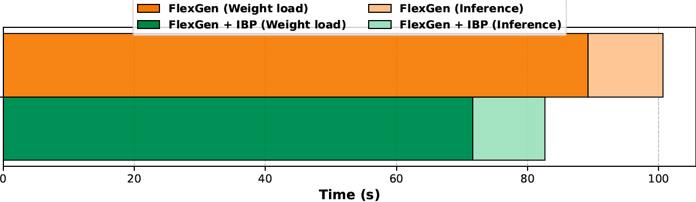
22% faster LLM inference for FlexGen with IBP
Model: Gemma-7B, Hardware: A100, 1,920 input, 128 output tokens
Time for loading weights 25% faster improving inference latency
Notes:
Since our paper was published, we also ran an experiment enhancing FlexGen, an LLM offloading framework, with IBP.
FlexGen offloads the model weights to CPU memory, fetching them layer-by-layer as needed, overlapped with ongoing compute. By using IBP’s compression, we were able to make model weight loading time 25% faster which translated to 22% faster end-to-end LLM inference.

Slide 76
Invariant bit packing highlights
ML applications suffer from the PCIe bandwidth bottleneck
IBP relieves bottleneck via ML data compression
  Identify invariant bits
  Eliminate and pack into smaller space
  Keep one set of metadata in GPU (order of KBs)
Up to 70% faster GNN training, DLRM inference, LLM inference
https://github.com/AKKamath/InvariantBitPacking
Notes:
ML applications suffer from a GPU memory bottleneck. Offloading moves the bottleneck from the GPU memory capacity to the PCIe bandwidth. IBP relieves this bottleneck through ML data compression. We find invariant bits, pack the data into a smaller space, then keep one set of metadata in the GPU. For parallelism we use warp-parallel iterative decompression. Our code is available on GitHub.

Slide 77
Future outlook: Expanded compression
Tiered compression for ML
Use multiple compression schemes synergistically. Compress aggressively for limited links, and less for larger links. E.g., heavy compression for network, but less across PCIe
KV-cache compression + recomputation
Store KV-cache in compressed form in GPU and CPU memory. Recompute portions, overlapping with decompression. Integrate decompression into attention.
Token transfers for Mixture-of-Experts:
Transfer compressed tokens across GPUs to reduce bandwidth, overlapping with compute.
Notes:
Lossless compression has been a largely overlooked aspect of mitigating data movement. I believe there’s still a lot of scope to be explored in this domain. [click] One possible path is to explore tiered compression, where data is more aggressively compressed for limited links, for example disk or network transfers, and as data comes closer to the processor, it’s less and less compressed. Smaller links benefit from high compression, and allow for longer decompression steps that can overlap with the transfer.
[click] The KV-cache stores large tensors. Recent work has shown that when the KV-cache exceeds GPU capacity and is streamed in across PCIe, it makes sense to recompute a portion of it, overlapped with ongoing transfers. I believe compression can also be overlapped here, as decompression is largely memory-bound. The three operations, transfers across PCIe, recompute, and decompression can all be overlapped as they all use different GPU resources.
[click] In distributed mixture of experts serving, tokens are moved across GPUs, I believe compression can be integrated here to reduce the impact of this inter-GPU movement.

Slide 78
Summary
Avoid - (MC)²
78% higher DB throughput
2) Hide - POD-Attention
59% faster LLM attention
3) Reduce - IBP
74% faster GNN training
Notes:
To summarize, data movement is a growing issue causing bottlenecks during application execution. I present a taxonomy of three mitigation techniques to counter this and demonstrate them with concrete projects. [click] (MC)^2 avoids data movement through lazy copying at the memory controller, providing up to 78% higher DB throughput. [click] POD-Attention hides data movement by overlapping bandwidth-heavy decode with compute-heavy prefill, providing 59% faster LLM attention. [click] IBP reduces data movement by losslessly compressing ML tensors, providing up to 74% faster GNN training.
Together this taxonomy provides a composable framework for analyzing potential data movement mitigations and the application characteristics required to exploit them.
Thank you!

Slide 79
Backup slides

Slide 80
Avoid: Lazy MemCopy for Databases and IPC
Published as:
(MC)²: Lazy MemCopy at the Memory Controller, ISCA 2024
Notes:
I discuss (MC)²: Lazy MemCopy at the Memory Controller, which makes use of the avoid technique by providing a lazy memcpy operation to improve database and IPC performance

Slide 81
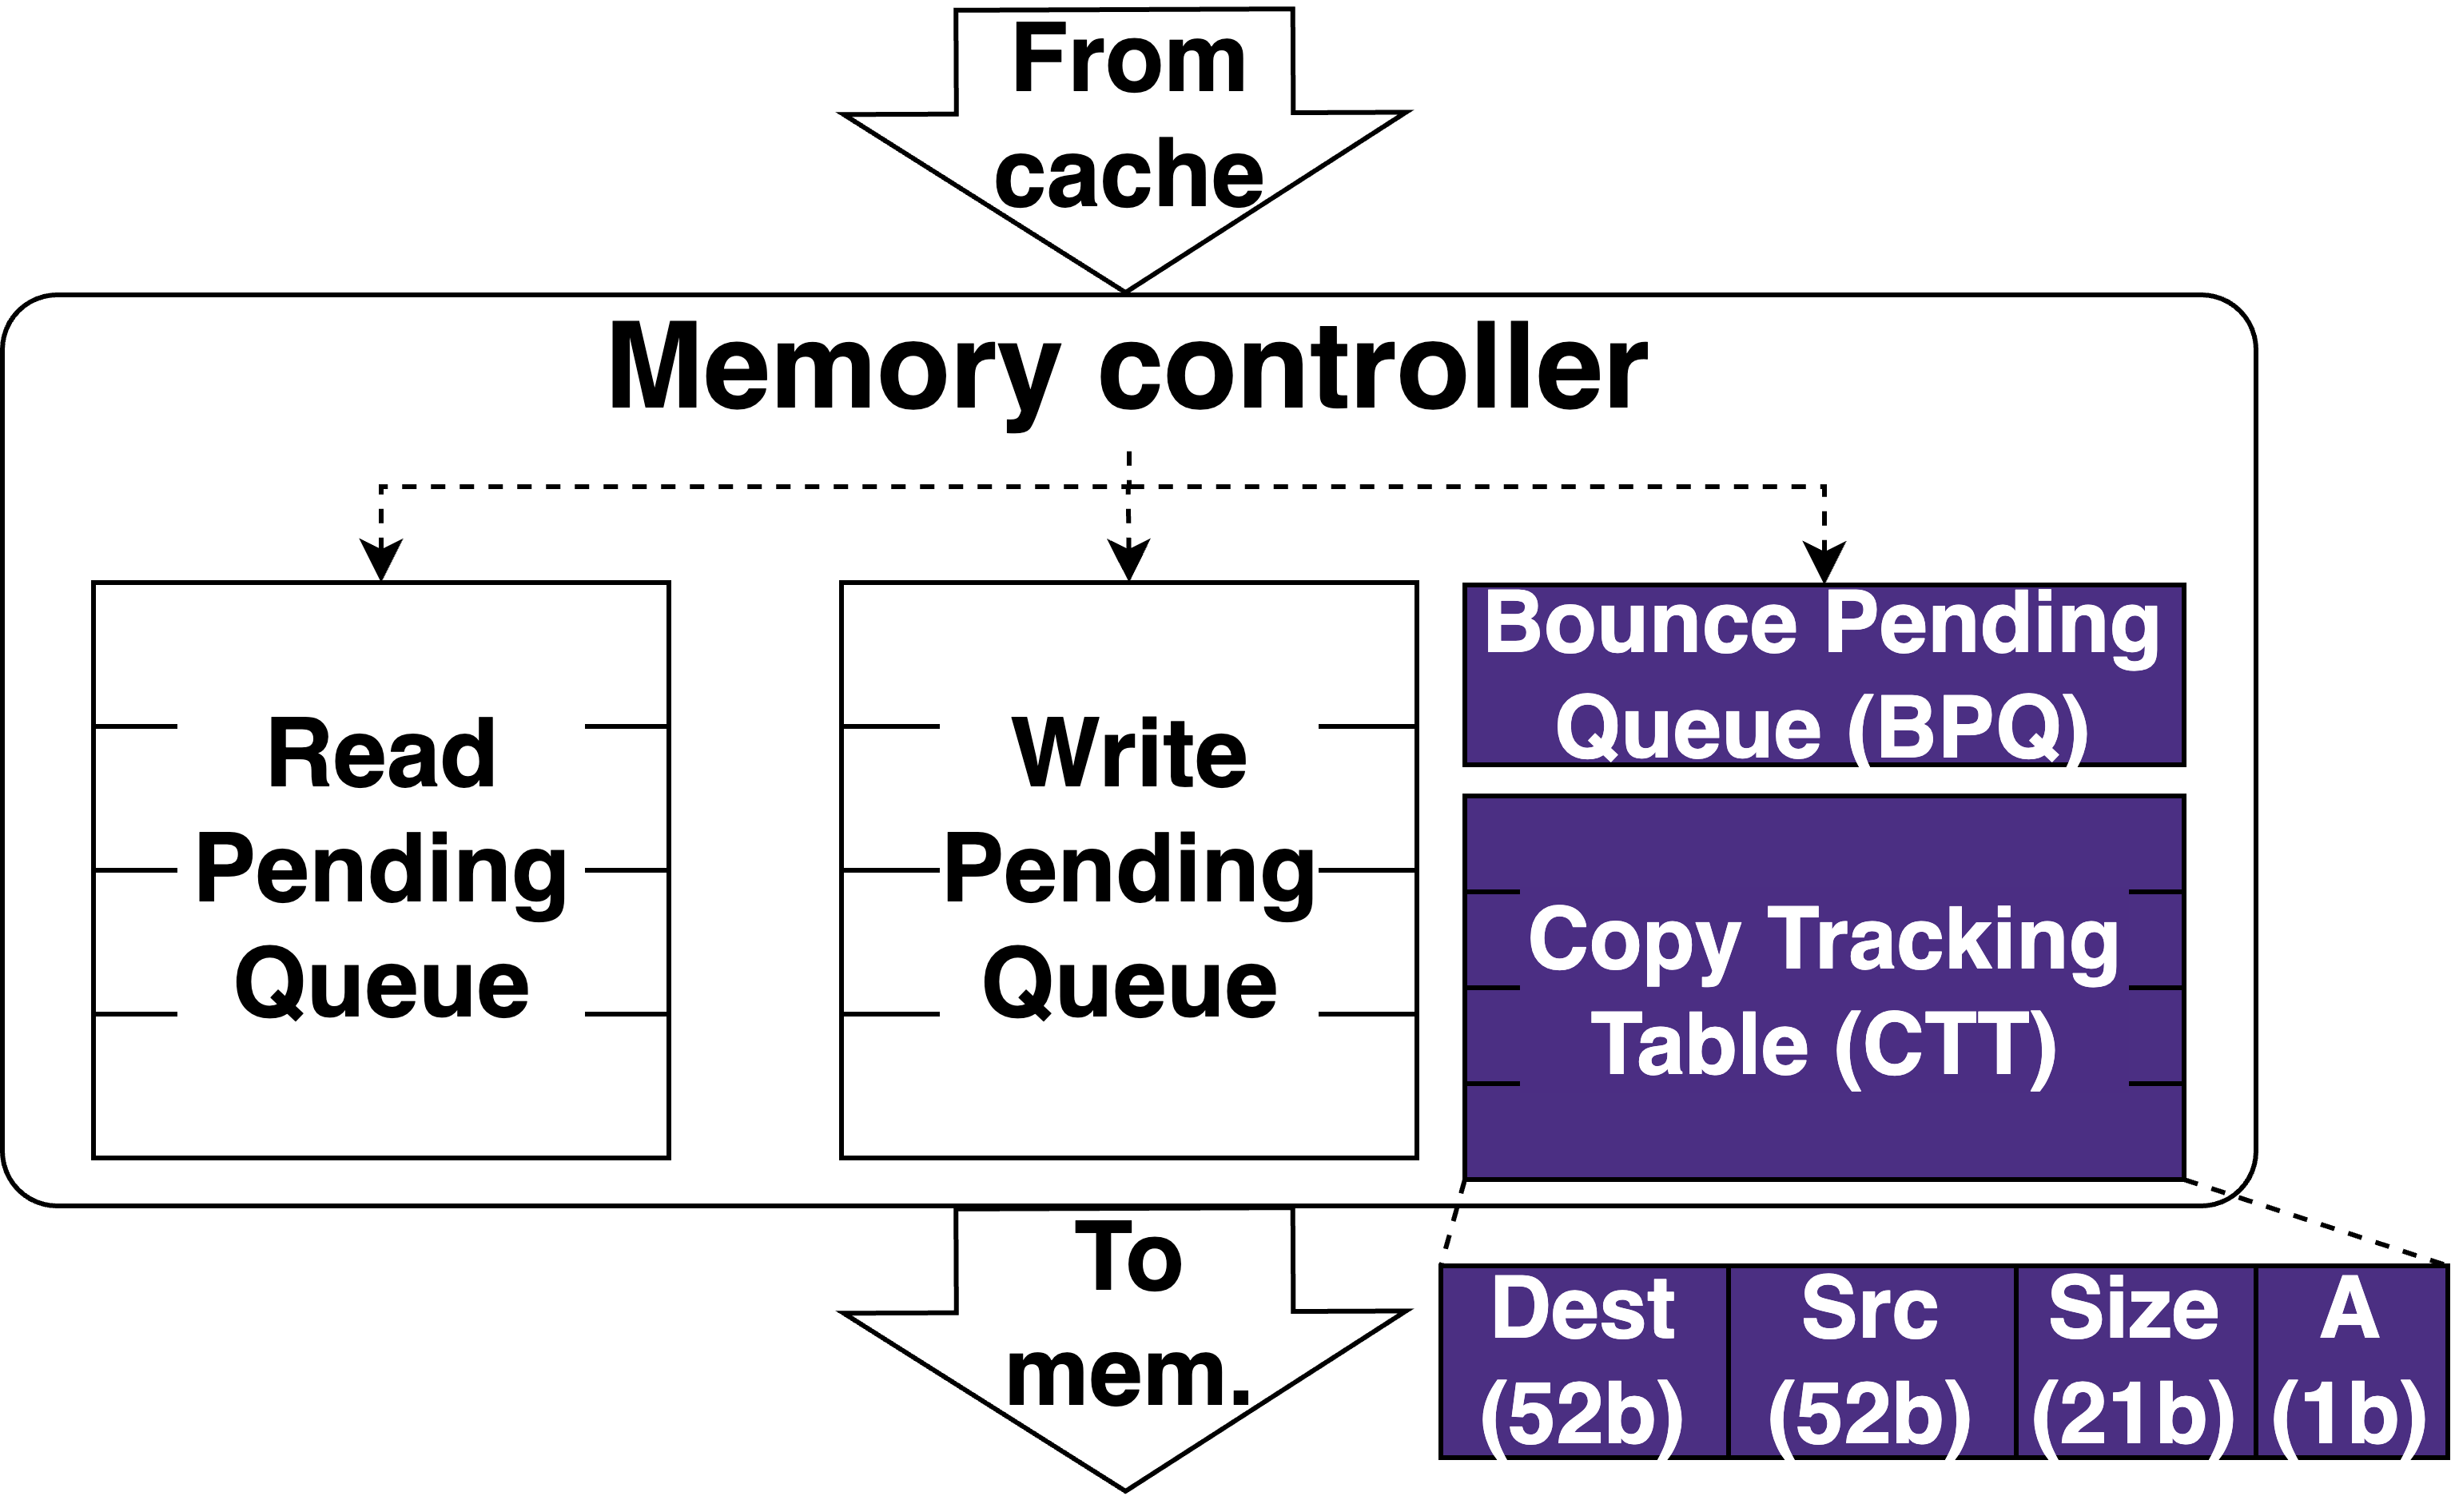
(MC)² Hardware
Notes:
We add a copy tracking table or CTT, which tracks all the prospective copies.
Each entry in this table contains a 52-bit destination address, a 52-bit source address, and 21-bit size of executed copies, along with an active bit to check whether the entry is in use. We use 52 bits for addresses since this is typically the size of physical addresses in systems today. The 21-bit size allows each entry to track a prospective copy of up to 2 MB in size or the size of a large page. The entries in the CTT are kept coherent across memory controllers. The CTT is looked up in parallel with memory accesses, hiding its access latency in the critical path.
We also maintain a bounce pending queue, that temporarily holds writes to source buffers for consistency. The importance of the BPQ is explained in detail in our paper.

Slide 82
(MC)² ISA
memcpy_lazy: C wrapper function with
semantics identical to memcpy
Operation | Operands
MCLAZY | R_{dest} , R_{src} , R_{size}
MCFREE | R_{addr} , R_{size}
Must be physically contiguous,
i.e., within a single page for user apps
Multiple of cacheline size
Destination:
Cacheline-aligned
Notes:
We provide two new instructions to take advantage of Mcsquare. The first is MCLAZY which initiates the lazy memcpy operation. It accepts 3 registers, the destination virtual address, the source virtual address and the copy size. The second instruction is MCFREE which is a hint that informs the system that the address provided is no longer in use and does not need to be tracked anymore.
MCLazy has a few alignment restrictions to simplify hardware. We provide software wrappers that hide these low-level constraints from the programmer. The first is that the destination buffer address must be cacheline-aligned. This is because memory accesses occur at cacheline granularity, and lazy copies on partial cachelines would make the hardware overly complex.
The second restriction is that the copy size must be a multiple of the cacheline size, for the same reason of avoiding partial cacheline copies.
The final restriction is that the destination and source buffers must be contiguous in physical memory. For userspace applications this means they must each lie within a single page. For copies spanning multiple pages, MCLAZY should be called on each page.
As previously mentioned, we provide a C wrapper around MCLAZY that exposes a lazy memcpy with identical semantics to libc memcpy for programmer convenience. Full details on how this is done are in the paper.

Slide 83
(MC)² operation: Lazy copy
Core
Core
MCLAZY
DEST, SRC, SIZE
Core
MCLAZY
DEST, SRC, SIZE
MCLAZY
DEST, SRC, SIZE
Last-level $
SRC
DEST
SRC
Interconnect
BPQ
Copy Tracking Table
Copy Tracking Table
BPQ
DEST
SRC
SIZE
A
Memory controller
Memory controller
DEST
SRC
SIZE
A
Memory
Memory
SRC
DEST
Notes:
We’ll now look at how the lazy copy operation is performed, and what happens on memory accesses.
Let’s assume the CPU core executes an MCLAZY operation on a destination and source cacheline. The CPU creates a packet for this operation and sends it towards the caches.
At the caches, the operation triggers an effect where the destination cacheline is invalidated, and the source cacheline is written back. This ensures that further accesses to the destination reach the memory and that the memory has the up-to-date values of src that were copied to dest.
The packet is then broadcasted to all the memory controllers where the operation is added to the Copy Tracking Table.
We’ll now see how reads to the destination buffer are impacted by this operation.

Slide 84
(MC)² operation: Read destination
Core
Core
Core
READ DEST
Last-level $
Interconnect
BPQ
Copy Tracking Table
Copy Tracking Table
BPQ
DEST
SRC
SIZE
A
Memory controller
Memory controller
DEST
SRC
SIZE
A
DEST
Memory
Memory
SRC
DEST
Notes:
When the CPU reads the destination, we need to obtain the data from the source instead, since the data wasn’t actually copied.
The access proceeds as normal initially.
At the memory controller, we consult the CTT and realize that this was the destination of a prospective copy.
This causes the request to be bounced to the memory controller containing the source cacheline.
The source cacheline is read from memory and sent the CPU core as if it was read from the destination memory location. Reads to the destination incur an additional latency due to the CTT lookup and bounce operations.
In our paper we also detail out how reads to the source and writes to the source or destination buffer is performed.

Slide 85
Reduce: Lossless Compression (IBP) for ML
Published as:
Reducing the GPU Memory Bottleneck with Lossless Compression for ML, EuroSys 2026
Notes:
I now discuss Invariant bit packing compression, which makes use of the reduce technique by compressing ML tensors before they’re transferred across the PCIe, reducing the volume of data moved.

Slide 86
Problem: Odd-sized output hinders parallelism
Compressed data (In CPU)
1 1
1 1
1 0
0 1
0 1
1 0 1 1
0 1 1 0
0 1 1 0 1 0 0
0 0 0 1 1 0 0 0 1
0 0 0 0 0 1 0 1 0
Notes:
However, with this compression, we now have a new problem. Unlike classic bit packing, where every compressed tensor is the same size, we now have tensors with unaligned offsets. Compressed data has to be read sequentially since we don’t know their exact size beforehand. This complicates decompression and makes parallelising operations difficult.

Slide 87
Solution: Warp-parallel iterative decompression
CPU memory
Compressed tensor
1010101110101011101011010001001010 1010101110101011101011010001001010
Contiguous data accesses provides best performance.
Region
1010101110101101000
Region
1010101110101101000
…
Async prefetch
GPU
Region
Warp
Mask
1 1 1 0 1 1 1 0 0 1 1 0
Notes:
For this, we introduce warp-parallel iterative decompression. [click] The compressed tensor is broken into multiple regions, each sized at a factor of the GPU cacheline size of 128 bytes. Since we don’t know the exact size of the compressed tensor, we can read data region-by-region, providing high bandwidth, while avoiding excessive data transfers. [click] The warp collectively reads a region into the GPU, while issuing an asynchronous prefetch to the next region. The async prefetch is an instruction available in newer which allows the memory access to overlap with compute, providing us pipeline parallelism between the transfers and decompression. [click] Once the data is brought to the GPU we can begin decompression.

Slide 88
Solution: Warp-parallel iterative decompression
CPU memory
Region
1010101110101101000
…
GPU
Warp-level primitive
…
Region
Offset:
0
1
4
Bits to read:
1
3
Mask
1 1 1 0 1 1 1 0 0 1 1 0
1 1 1 0 1 1 1 0 0 1 1 0
Notes:
For simplicity, we depict 2 threads within the warp, though a warp consists of 32 threads. Each thread in the warp is responsible for decompressing a chunk of the output tensor. [click] Each thread first reads the number of 0 bits in their corresponding mask chunk. This lets the thread know the number of bits it needs to read from the region. A problem is that decompressing a chunk is reliant on the previous chunks as the bit offset to begin reading from the region is unknown, hurting parallelism. [click] To resolve this, these threads communicate with each other, performing a prefix sum operation where they add up the number of bits to add from previous threads. As these threads all belong to the same warp, we make use of warp primitives which are cycle-latency communication instructions. [click] This gives each thread a bit offset, which lets it know where in the region to start reading bits from.

Slide 89
Solution: Warp-parallel iterative decompression
CPU memory
Region
1010101110101101000
…
Async prefetch
GPU
…
Region
Decompressed
Offset:
0
1
4
Bits to read:
1
3
Mask
1 1 1 0 1 1 1 0 0 1 1 0
Notes:
They now begin reading the bits from the region. [click] and write to the decompressed tensor location. When this is finished, the process is repeated for the next set of chunks in the tensor, [click] issuing another async read for the next region. Each tensor required is decompressed by a separate warp. In this way we extract parallelism from a sequential process.

